Slide 1
SharePoint Foundation 2010
Session I
http://www.profburnett.com

Slide 2
Outline
What is SharePoint Foundation?
Team Collaboration and Sharing.
SharePoint Foundation User Permissions
SharePoint Foundation and Windows SharePoint Services.
Integration with SharePoint Foundation.
Relationships between SharePoint Foundation and SharePoint Server 2010
SharePoint Designer 2010.

Slide 3
What is SharePoint Foundation?
Enables organizations improve team productivity
Increase the efficiency of business processes.
Team Collaboration and Sharing

Slide 4
Team Collaboration and Sharing
Capture and share ideas, information, communication, and documents.
Facilitates team participation in discussions, shared document collaboration, blogging.,
Building knowledge bases using wikis, and surveys.
Document collaboration features with
check-in and checkout
document version control
recovery of previous versions
document-level security.

Slide 5
SharePoint Foundation User Permissions
Read - This permission level gives you read-only access to the website.
Contribute - In addition to all the permissions included in the Read permission level, the Contribute permission level allows you to create and edit items in existing lists and document libraries.
Design - In addition to all the permissions included in the Contribute permission level, the Design permission level allows you to create lists and document libraries, approve items, and edit pages in the website.
Full Control - This permission level gives you full control.
Limited - The Limited permission level allows access to a shared resource within a site, such as a specific list, document library, folder, list item, or document, without giving access to the entire site.

Slide 6
SharePoint Foundation
Evolution of Microsoft Windows SharePoint Services
Windows SharePoint Services 3.0
Windows SharePoint Services 2.0
SharePoint Team Services

Slide 7
Integration with SharePoint Foundation
Create a Workspace site from an Office 2010 application or from a browser.
Microsoft Word 2010
Microsoft Excel 2010
Microsoft PowerPoint 2010
Microsoft InfoPath 2010
Microsoft OneNote 2010
Integration with Office Web Apps

Slide 8
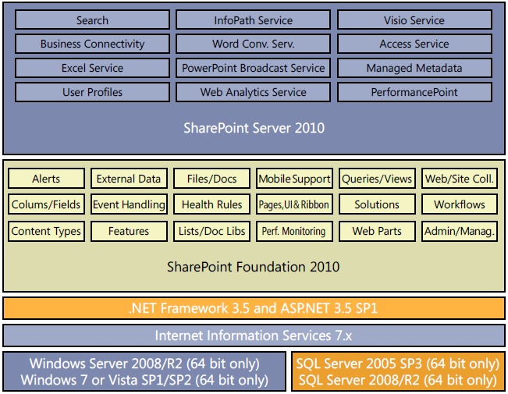
Relationships between SharePoint Foundation and SharePoint Server 2010

Slide 9
SharePoint Designer 2010.
Tools to tailor SharePoint sites.
Free download.
Rich customization of sites.
Creation of reporting tools and application templates.
Designing Workflows without writing any code.

Slide 10
Chapter 2 - Navigating a SharePoint Site
Customizing the Top Navigation Area - Page 32
Customizing the Left Navigation Panel - Page 36
Understanding Web Parts - Page 40

Slide 11
Chapter 3 - Creating and Managing Sites
Creating a Child Workspace - Page 66
Changing a Site’s Theme - Page69

Slide 12
Chapter 4 - Working with Lists
Creating a New List - Page 89
Adding and Editing List Items - Page 93
Adding, Editing, and Deleting List Columns - Page 101

Slide 13
Chapter 5 - Working with Libraries
Creating a Document Library - Page 120
Creating a New Document - Page 122
Editing Documents - Page 124
Adding Documents - Page 126
Creating a New Folder in a Library - Page 138
Checking Documents In and Out - Page 139
Working with Version History - Page 142

Slide 14
Chapter 6 - Working with Web Pages
Editing a Page - Page 156
Creating a New Page - Page 160
Adding Links - Page 163
Working with Page History and Versions - Page 165
Adding a Web Part from the Web Part Pane - Page 168
Removing a Web Part - Page 172

Slide 15
Chapter 7 - Working with List Settings
Setting the List Title, Description, and Navigation - Page 185
Configuring Content Approval and Versioning - Page 187
Creating a Content Type - Page 194
Associating a Content Type with a List - Page 197
Managing Users and Permissions - Page 203
Granting List Item Permissions - Page 206

Slide 16
Chapter 8 - Working with Library Settings
Opening Documents in the Client or the Browser - Page 221
Modifying a Library Template - Page 222
Configuring Required Checkout - Page 224
Enabling Versioning - Page 226
Configuring the Sites Assets Library - Page 233
Creating a View - Page 244

Slide 17
Review
What is SharePoint Foundation?
Team Collaboration and Sharing.
SharePoint Foundation User Permissions
SharePoint Foundation and Windows SharePoint Services.
Integration with SharePoint Foundation.
Relationships between SharePoint Foundation and SharePoint Server 2010
SharePoint Designer 2010.

