Slide 1
SharePoint Foundation 2010
Chapter 1
http://www.profburnett.com

Slide 2
Outline
What is SharePoint Foundation?
Team Collaboration and Sharing.
SharePoint Foundation User Permissions
SharePoint Foundation and Windows SharePoint Services.
Integration with SharePoint Foundation.
Relationships between SharePoint Foundation and SharePoint Server 2010
SharePoint Designer 2010.

Slide 3
What is SharePoint Foundation?
Enables organizations improve team productivity
Increase the efficiency of business processes.
Team Collaboration and Sharing

Slide 4
Team Collaboration and Sharing
Capture and share ideas, information, communication, and documents.
Facilitates team participation in discussions, shared document collaboration, blogging.,
Building knowledge bases using wikis, and surveys.
Document collaboration features with
check-in and checkout
document version control
recovery of previous versions
document-level security.

Slide 5
SharePoint Foundation User Permissions
Read - This permission level gives you read-only access to the website.
Contribute - In addition to all the permissions included in the Read permission level, the Contribute permission level allows you to create and edit items in existing lists and document libraries.
Design - In addition to all the permissions included in the Contribute permission level, the Design permission level allows you to create lists and document libraries, approve items, and edit pages in the website.
Full Control - This permission level gives you full control.
Limited - The Limited permission level allows access to a shared resource within a site, such as a specific list, document library, folder, list item, or document, without giving access to the entire site.

Slide 6
SharePoint Foundation
Evolution of Microsoft Windows SharePoint Services
Windows SharePoint Services 3.0
Windows SharePoint Services 2.0
SharePoint Team Services

Slide 7
Integration with SharePoint Foundation
Create a Workspace site from an Office 2010 application or from a browser.
Microsoft Word 2010
Microsoft Excel 2010
Microsoft PowerPoint 2010
Microsoft InfoPath 2010
Microsoft OneNote 2010
Integration with Office Web Apps

Slide 8
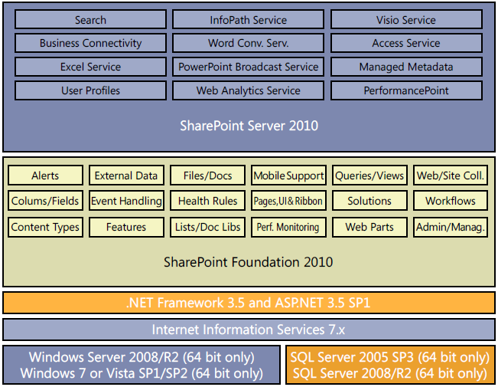
Relationships between SharePoint Foundation and SharePoint Server 2010

Slide 9
SharePoint Designer 2010.
Tools to tailor SharePoint sites.
Free download.
Rich customization of sites.
Creation of reporting tools and application templates.
Designing Workflows without writing any code.

Slide 10
Review
What is SharePoint Foundation?
Team Collaboration and Sharing.
SharePoint Foundation User Permissions
SharePoint Foundation and Windows SharePoint Services.
Integration with SharePoint Foundation.
Relationships between SharePoint Foundation and SharePoint Server 2010
SharePoint Designer 2010.

