Slide 1
HTML5 Level I
Session I
Chapter 18 - How to Design a Web Site www.profburnett.com

Slide 2
Class Outline
Users and Usability
Design Guidelines
Design Methods and Procedures
Responsive Web Design

Slide 3
Users and Usability
What Do Users Want?
Quick & Easy Info
Easy-to-Use

Slide 4
Users and Usability
How do Users Use a Web Page?
Click Buttons
Scan
Click Links
Give Up

Slide 5
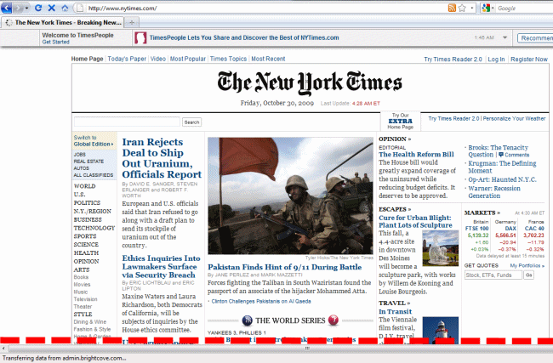
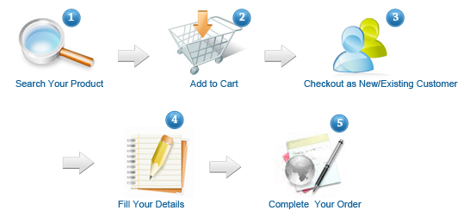
Improving Usability
Above the Fold
Group Components
Communicate Order
Adhere to Conventions

Slide 6
Usability Conventions
Header Conventions
Logo, Tag Line, Utilities
Unique Tag Line
Nav Bar Sectionalizes
Utilities - Useful - Not Prime
May include Search
Navigation Conventions
Underlined Text
Image Text Clickable
Image Clickable
Buttons 3D
Column Text Clickable
Cart Symbol – Shopping Cart
Logo Image – Home Page

Slide 7
Home Page Design Guidelines
Emphasize Value and Difference
Empathize Highest Priority
Don’t Welcome – Waste of Space
Group Navigation
Use Icons for Navigation
Use Dropdowns for Navigation
Home Page Different from main pages
No Active link on Home Page to Home Page
Home Page Title = Organization Name
Ecommerce – Include Shopping Cart Symbol and Link

Slide 8
Space Design Guidelines
Breadcrumbs
Keep Header Small
Prioritize Components
Give Important Item Priority Location

Slide 9
Web Writing Guidelines
Use Fewer Words
Inverted Pyramid
Use Heading and Subheadings
Use Bulleted and Number Lists
Use Tables
Don’t Use All Caps
Make Text Links Explicit
Chunk Long Pages into Shorter pages

Slide 10
Graphic Design Principles
Alignment
Proximity
Repetition
Contrast

Slide 11
Typographical Guidelines
Limit Paragraphs to 65 Characters
Use San Serif Fonts that are Easy to Read
Show Heading and Text Relationship
Dark Text / Light Background
Don’t Center or Justify Text
No Space for Indented First Lines
Don’t Reverse Text

Slide 12
Design Methods and Procedures

Slide 13
Developmental Team
For Design
Requirements Specialist
Usability Specialist
Marketing Specialist
Writers
Web Designers
Graphic Designers
For Implementation
HTML & CSS Specialist
Client-side Programmers
Server-side Programmers
XML Programmer
DBA
Network Admin

Slide 14
Design Methods
Top-Down - SDLC
Stepwise – Iterative
Prototyping
RAD
JAD
Extreme - Agile

Slide 15
Web Site Lifecycle
Design
Implement
Maintain

Slide 16
Easy to Maintain Web Site
Use HTML for Content
Use CSS for Layout and Formatting
Don’t Use Tables
Don’t Use Frames
Get Design Right First

Slide 17
Procedure for Designing Web Site
Define Audience and Goals
Design Home Page
Design Primary Content Pages
Design Other Pages
Plan Navigation
Plan Folders

Slide 18
Plan Navigation
Home
Page
FAQ
Help
About
Us
Contact
Us
Shopping
Cart
Products
Services
Board
History

Slide 19
Plan Navigation – Personal Website
Home Page
Knowledge's (Strengths)
Skills
Abilities (What Jobs I can Do)
Employment History
Current
Historical
Hobbies
About Me
Where I Grew Up
Where I Live Now
Education’
Contact Me

Slide 20
Plan Folders
Root
Products
Services
Images
About Us
Single
Pages
Shopping Cart

Slide 21
Plan Folders – Personal Website
Root Folder
About Me Folder
Employment History Page Folder
Education Page Folder
Other Page Folder
Images Folder
PDF File Folder
.DOC File Folder
Graphics Folder
Button Folder
Home Page
About Me Page

Slide 22
Implementing Web Site
Develop HTML & CSS Templates
Develop Web Pages
Test Entire Site
Deploy Site

Slide 23
Maintaining Web Site
Plan Changes
Design Changes
Test Changes
Deploy Changes

Slide 24
Responsive Web Design (RWD)
Flexible images are also sized in relative units, so as to prevent them from displaying outside their containing element.

Slide 25
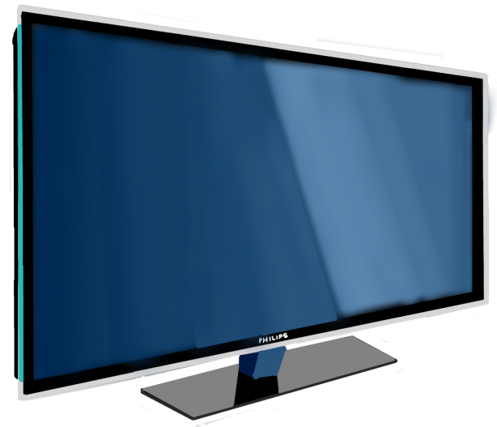
Responsive Web Design (RWD)
Media queries allow the page to use different CSS style rules based on characteristics of the device the site is being displayed on, most commonly the width of the browser.

Slide 26
Templates & Frameworks
Web Based
HTML5
CSS3
JavaScript
Mobile

Slide 27
Class Review
Users and Usability
Design Guidelines
Design Methods and Procedures
Responsive Web Design
Next –Chapter 2 - How to Code, Test and Validate a Web Page

