Slide 1
Digital Literacy for the 21st Century
Session V – Cloud Computing http://www.profburnett.com

Slide 2
Outline
What is Cloud Computing?
What are the Different CC Service Models?
Why are Consumers Moving to the Cloud?
What are the Consumer-Based SaaS?
What is Cloud Storage?
What are Cloud Productivity Applications?
What are Cloud Media Services?

Slide 3
What is Cloud Computing?
Tom Guisto - How to use the Cloud safely.
Ken Lechter - How is the Cloud different than server farms?

Slide 4
What are the Different CC Service Models?
Software as a Service (SaaS)
Platform as a Service (PaaS)
Infrastructure as a Service (IaaS)

Slide 5
Cloud Computing Benefits
Agility
Cost reductions
Device and Location Independence
Maintenance
Multitenancy
Performance
Productivity
Reliability
Scalability and Elasticity
Security

Slide 6
Cloud Computing Issues
Reliability
Availability of services
Data access
Security
Complexity
Costs
Regulations and Legal Issues
Performance
Migration
Reversion
Lack of Standards
Limited Customization
Privacy Issues

Slide 7
Infrastructure as a Service (IaaS)
Service
Examples
Virtualization
Servers
Storage
Load Balancing
Network Services
Amazon Web Services (AWS)
Windows Azure
Google Compute Engine
Rackspace Open Cloud
IBM SmartCloud Enterprise.

Slide 8
Platform as a Service (PaaS)
Service
Examples
Development environment to application developers
Specialized Applications
Tailored Data Applications
Amazon Elastic Compute Cloud
Google App Engine
Windows Azure Development
Rackspace Cloud
Cisco Unified Computing System
Squarespace
Verizon Enterprise Solutions
GitHub

Slide 9
Software as a Service (SaaS)
Services
Examples
Business Applications
Customer Relationship Management (CRM)
Management Information Systems (MIS)
Enterprise Resource Planning (ERP)
Human Resource Management (HRM)
Talent Acquisition
Content Management (CM)
Antivirus Software
Service Desk Management (SDM)
Supply Chain Management (SCM)
Health Care Management
SalesForce.com
Office365
Google Mapping
Netflix
Adobe Creative Cloud
Dropbox

Slide 10
Why are Consumers Moving to the Cloud?
Consumer Demands
Growth of Internet Users
Unfettered Access to Data
Multiple Devices
Location Independence

Slide 11
Technology Developments
Increased Internet Bandwidth
Fiber to the Home (FTTH)
Wireless Networks (WiFi, WiMAX, WiBro)
Powerful Portable Devices (Smartphones)
Significantly Reduced Cost of Storage (.003 per GB)

Slide 12
What are the Consumer-Based SaaS?
Type
Key Drivers
Social Media
Video Services
Music Services
Communications
Productivity Applications
Digitalization
Cord Cutting
Open Source / Piracy
Utility Computing
VOIP

Slide 13
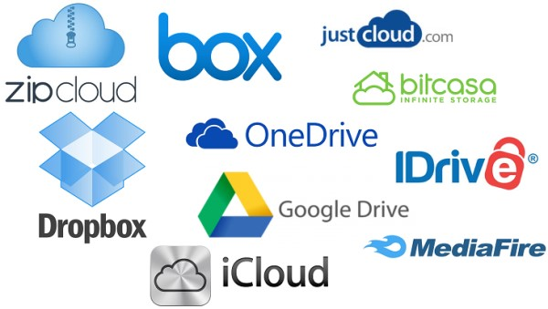
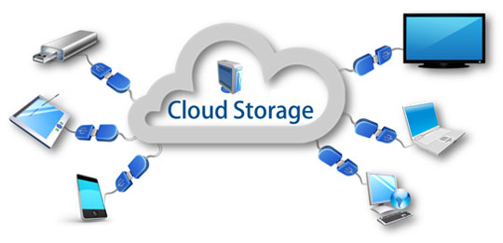
What is Cloud Storage?

Slide 14
Cloud Storage
Advantages
Disadvantages
Pay for the storage you use.
Cut energy consumption.
Storage availability and data protection.
Outsource storage maintenance tasks.
Access to resources and applications.
Natural disaster backup.
Outsourcing data storage increases potential for attack.
Supplier stability.
Accessibility
Security of stored data
May enable Piracy and Copyright Infringement.

Slide 15
Cloud Storage
Service | Microsoft OneDrive | DropBox | Google Drive | iCloud | Amazon Cloud Drive
File size restrictions | 10GB | 10GB with website, none with Dropbox apps | 5TB | Unknown | 2GB*
Free storage? | 5GB** | 2GB | 15GB | 5GB | No***
Device Account Needed | No | No | No | Yes | No
Paid plans | $2/month for 50GB** | $10/month for 1TB | $2/month 100GB, $10/month for 1TB | 50 GB, 200 GB, or 1 TB. | $12/year for unlimited photos, $60/year for unlimited files
OSes supported | Windows, Mac, Android, iOS, Windows Phone | Windows, Mac, Linux, Android, iOS, Windows Phone, BlackBerry, Kindle Fire | Windows, Mac, Android, iOS | iOS device running iOS 5 or later or a Mac running OS X Lion v10.7.5 or late | Windows, Mac, Android, iOS, Kindle Fire

Slide 16
Cloud Storage
Service | Verizon Cloud | Xfinity (Office 365)
File size restrictions | 5GB | 10GB
Free storage? | Yes | 5GB**
Device Account Needed | Yes | No
Paid plans | 3 Plans 25 GB – 2.99 250 GB – 4.99 1 TB – 9.99 | $2/month for 50GB**
OSes supported | Windows, Mac, Android, iOS, | Windows, Mac, Android, iOS, Windows Phone

Slide 17
Exercise 1 - Cloud Storage
Count the cloud storage services you have access to.
List the cloud storage services you use.

Slide 18
Cloud Office Applications
Advantages
Disadvantages
Cost is low.
no download or install of software.
Run on thin clients.
No need to purchase or upgrade a software license.
Portable.
Documents still safely if the user’s computer fails.
Access requires connectivity.
Speed and accessibility issues.
Number of features available can be an issue.
Subscription charge to use the service.
No control over the version of the software.
Reliant on the service provider for security and privacy.

Slide 19
Cloud Office Applications
Service | Office 365 | Google for Work | ZoHo Docs | ThinkFree | Adobe Buzzword
Price | $5 per Month for Year | $5 per Month $60 per Year | Free & Up | Free – 30 days | Free
Storage | 1 TB | Drive (30GB) | Docs: 5/250/1000GB | 1GB | 50GB
Plan Choices | Multiple | 6 Options | 10 Plans
Apps | Word Processor Spreadsheet Presentation Email Calendar Site Builder Messaging Note Organizer | Word Processor Spreadsheet Presentation Email Calendar Site Builder Messaging Note Organizer | Word Processor Spreadsheet Presentation Email Calendar Site Builder Messaging Note Organizer Project Management | Word Processor Spreadsheet Presentation Notes Blogs | Word Processor
Commitment | Monthly | Annual | Monthly | Monthly | Monthly

Slide 20
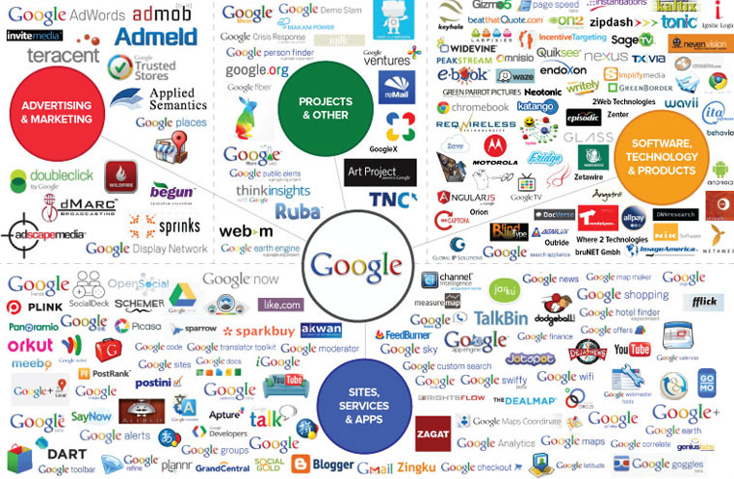
Google Products
Google Products

Slide 21
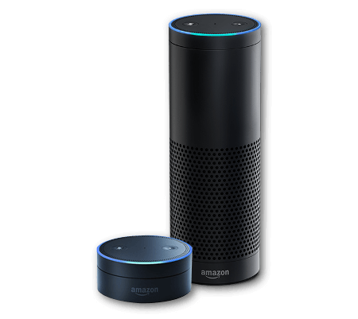
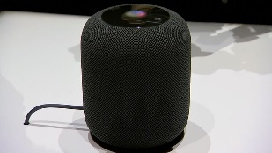
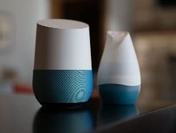
Virtual Assistants
A virtual assistant is a software agent that can perform tasks or services for an individual.
Software
Amazon Alexa
Google Assistant / Google Allo
IBM's Watson
Apple Siri
Microsoft Cortana
Devices
Amazon Echo
Apple HomePod
Google Home

Slide 22
Big Data Analytics Platforms
1010data
Actian (Ingres Corp)
Amazon Web Services
Cloudera
HAVEn (HP)
Hortonworks
IBM
InfiniDB
Infobright
Kognitio
MapR
Oracle
Pivotal
SAP
SAS
Teradata

Slide 23
Data Analytics Applications
Looker
Microsoft Power BI
Tableau Desktop
Domo
Qlik Sense Enterprise Server
Zoho Reports
Clearify QQube
Terapeak
Style Scope
Logi Info
Mozenda
Intelex
Sage X3
Host Analytics Cloud EPM Suite
Roambi Analytics
Vanguard Financial Forecasting
Tour de Force BI
InetSoft Style Intelligence
Sisense
Wave Analytics
Neubrain
Clear Analytics
Dundas BI
Adaptive Discovery
Google Analytics Premium

Slide 24
Exercise 2 – Cloud Productivity Services
Access Your School Online Office 365 account.
See MC Claim Your Account handout.

Slide 25
What are Cloud Media Services?
Television
Video
Music
Pictures
Mapping

Slide 26
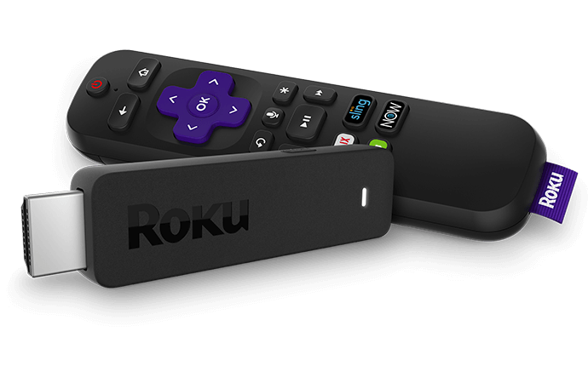
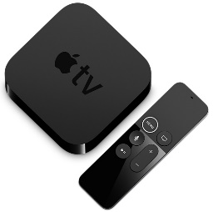
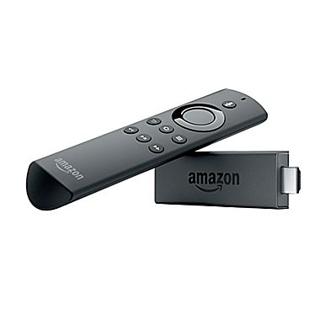
Cloud TV
CloudTV – Uses Internet Protocol Television (IPTV)
Software platform that virtualizes:
Customer Premises Equipment (CPE) or;
Set-top Box (STB) functionality.
Over The Top (OTT) online video service providers include:
Netflex
YouTube
Hulu
Amazon Prime
Apple TV
Over The Top (OTT) STP video service providers include:
Roku
Apple TV
Amazon Fire
Google Chromecast 2

Slide 27
Cloud Media Services - Video
Service | YouTube | YouTube Red | Netflix | Hulu Plus | Amazon Prime | Sling TV
Price |  | $9.99 per month | $9.99 per month | $7.99 per month | $8.99 per month | $20 per month
Registered Users |  |  | 81 M
Titles |  |  | 4,335 movies and 1,197 TV shows |  | 40,000
Platforms | Android, iOS, and, Web | Android, iOS, and, Web | 86 | Android, iOS, and, Web | Android, iOS, and, Web

Slide 28
Cloud Media Services - OTT
Service | Roku Express | Roku Streaming Stick | Roku Streaming Stick+ | Roku Ultra 4K
Price | $29.99 | $49.99 | $69.99 | $99.99
4K (HDR) | NO | YES | YES | YES
Service | Apple TV | Apple TV 4K (32GB) | Apple TV 4K (64GB)
Price | $149.00 | $179.00 | $199.00
4K (HDR) | NO | YES | YES
Service | Amazon Fire TV Stick | Amazon Fire TV 4k Ultra HD | Amazon Fire TV 4KHD w/Channels
Price | $39.99 | $69.99 | $79.99
4K (HDR) | NO | YES | YES
Service | Google Chromecast | Google Chromecast Ultra
Price | $35.00 | $69.00
4K (HDR) | NO | YES

Slide 29
Cloud Media Services - Music
Service | Spotify | Pandora | Napster / Rhapsody | SoundCloud | Groove Music | Apple Music | iTunes
# of Users | 75 M | 77 | 2.5 M | 175 M |  | 15 M | 800 M
# of Tracks | 30 M | 1.5 M | 32 M | 100 M | 40 M | 37 M | 40 M songs, 2.2 M apps, 25 K TV, 65 K Films
Platform | Web, Windows, iOS, Android Palm, Sonos, Symbian, Boxee, Telia Digital-TV, Virgin TiVo, webOS, Linux, PlayStation, Blackberry, Chromecast, Amazon Echo | Web, Windows, iOS, Android, Blackberry | Web, Windows, iOS, Android | Web, Windows, iOS, Android | Web, Windows, iOS, Android, Windows Phone Xbox 360, Xbox One, Sonos | Web, iOS, Android | Web, Windows, iOS, Android

Slide 30
Cloud Media Services - Pictures
Service | Flickr | 500 Pixels | Photobucket | Canon Irista | SmugMug | My Portfolio
Cost | $5.99 / Month $49.99 / Year | $4.99 Pro 14.99 Pro+ | $1.49 / Month $8.99 / Month |  | B - 3.99 / Month P - 5.99 / Month Port - 14.99 / Month Bus - 29.99 / Month | Free with Adobe CC
Registered Users
Storage | 1TB Free | 2,000 Photos | 100 GB | 15 GB | Photo - 150 MB Video - 3 GB
Ads | Free – Yes Paid - No | Free – Yes Paid - No |  | Free – Yes Paid - Yes
Other

Slide 31
Cloud Media Services - Pictures
Service | iCloud | Google Photos | Dropbox | OneDrive | ISP
Cost | Included in Apple account | With Google account | Basic - Free Plus – 9.99 Month Pro – 19.99 Month | Free with Outlook of Office 365
Registered Users
Storage | 5 GB 50 GB 200 GB 2 TB | 15 GB | 2 GB 1 TB 1 TB | 5 GB 50 GB 1 TB 5 TB
Ads
Other

Slide 32
Student Exercise 3
List the Cloud Media Services You Have Access to.
_____________
_____________
_____________
_____________
_____________
List the Cloud Media Services You Use.
_____________
_____________
_____________
_____________
_____________

Slide 33
Cloud Mapping Services
Google Maps
Bing Maps
Yahoo Maps (Verizon)
MapQuest
OpenStreetMap
Rand McNally Maps
HERE
TomTom Navigator
TomTom Mobile
Waze

Slide 34
Student Exercise 4
Why do you like the Cloud Services you use?
What Cloud Services would you like to use more?
What are you next steps to use more Cloud Services?

Slide 35
Review
What is Cloud Computing?
What are the Different CC Service Models?
Why are Consumers Moving to the Cloud?
What are the Consumer-Based SaaS?
What is Cloud Storage?
What are Cloud Office Applications?
What is Cloud Social Media?
What are Cloud Media Services?
Next Session – Digital Security & Privacy

