Slide 1
Digital Literacy for the 21st Century
Session III – Telecommunications, Internet, & World Wide Web http://www.profburnett.com

Slide 2
Outline
Telecommunications, Internet, & World Wide Web
What are Telecommunication Services?
Digital Transformation
What is the Internet?
What is the World Wide Web?
How Do You Use the Worlds Wide Web?
Mobile Telecommunication Devices
Smartphone Capabilities
What is the Internet of Things (IoT)

Slide 3
Student Questions
Mike Feuerstein
Q1 – How to understand different technologies to use them more effectively. - Session I - VI
Q2 – Learn about the range of digital technologies and what they can do. - Session I - VI
Dennis Thornton
Q1 – Is digital technology the end game? – Session I – VI
Q2 – Difference between WiFi and mobile networks? – Session II & III
Yvette Lamb
Q1 – How is it (possible) that a range of devices (phone, computer, etc.) can connect and “know” how to work together. - Session II & III
Q2 – Is there a key skill to master to understand digital technology? - Session I - VI

Slide 4
Student Questions
Karen Lechter
Q1 – How do I keep up with all the constant change in the digital world? - Session I - VI
Q2 – Will it become easier to use digital technology in the future or will things change too fast? - Session I - VI
Q3 – Is it hopeless for me to expect to be digitally literate as time goes on? - Session I - VI

Slide 6
What are Telecommunication Services?
Telecommunication Services are services provided by a telecommunication service provider.
Consumer telecommunication services include:
Phone
Television
Radio
Data
Internet
Security – Perimeter / Fire
Utilities – Electric & Water
Health Care – Remote Monitoring / Emergency Notification

Slide 7
Phone Telecommunication Services
Wired Telephone Services
Plaint Old Telephone Service (POTS)
ISDN
Data Network – Voice Over the Internet Protocol (VOIP)
Wireless Telephone Services (Mobile)
3G (Global System for Mobile Communication – GSM)
4G (Long Term Evolution – LTE) – (VOIP)

Slide 8
Global Navigation Satellite Systems (GNSS)
Global Positioning System (GPS) – US
Assisted Global Positioning Systems (A-GPS) - US
Local Area Augmentation System (LAAS) - US
Global'naya Navigatsionnaya Sputnikovaya Sistema (GLONASS) - Russian
Galileo - EU
BeiDou-2 - China
NAVigation with Indian Constellation (NAVIC) - India
Quasi-Zenith Satellite System (QZSS) - Japan

Slide 9
Television Telecommunication Services
Broadcast Television
Standard Definition – SDTV (Shutdown in 2009)
Digital Television – DTV
High Definition Television - HDTV
Cable Television Services – Digital Television (DTV / HDTV)
Satellite Television Services - Digital Television (DTV / HDTV)
Streaming Internet Television Services
Digital Television (DTV / HDTV)
Internet Protocol Television - IPTV

Slide 10
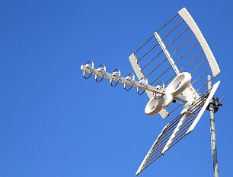
How to Access Alternate Television Stations
OTT Streaming Media Devices
Digital Broadcast
Amazon Fire
Roku
DMV – 108 Channels
ChromeCast
Nvidia Shield
Apple TV
Online Sites

Slide 11
Radio Telecommunication Services
Broadcast Radio
Terrestrial Digital Radio Broadcasting
Digital Audio Broadcasting
Satellite Radio Services

Slide 12
Data Telecommunication Services
Internet Services
Home Energy Monitoring Services
Home Alarm Services
Telemedicine
Home Emergency Health Care Monitoring Services

Slide 13
What is the Internet?
WANs
WANs
WANs
MANs
MANs
CANs
CANs
CANs
LANs
LANs
LANs
LANs
LANs
LANs
LANs
LANs
LANs

Slide 15
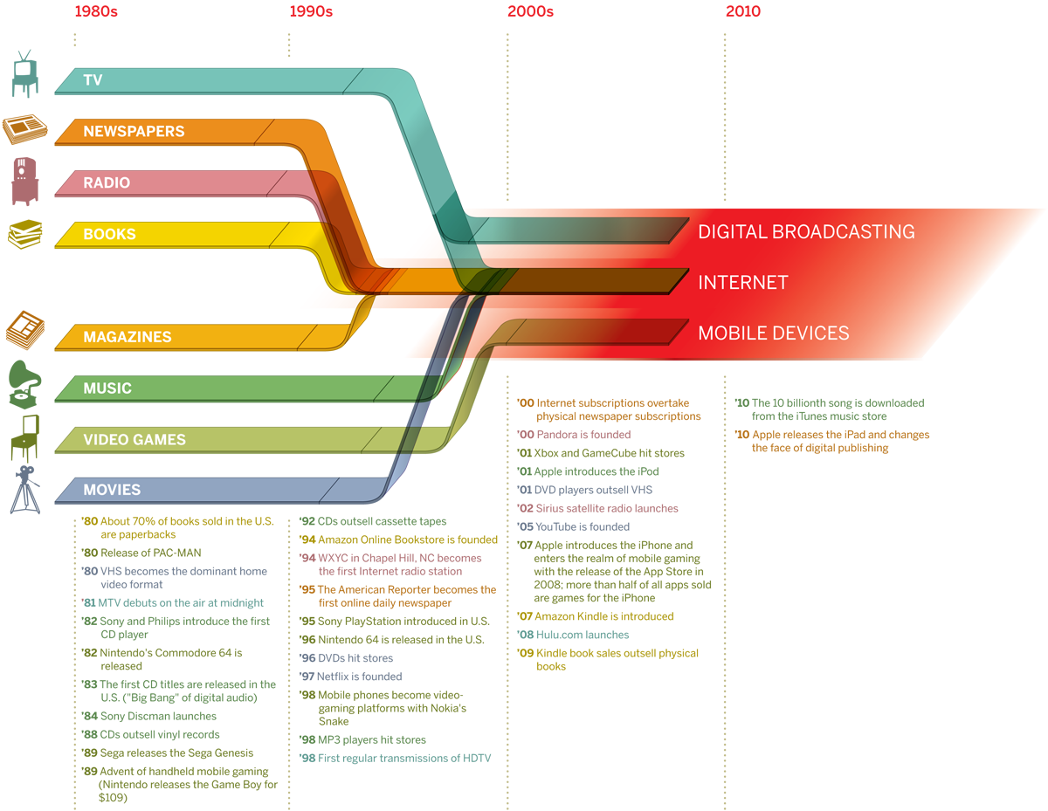
Digital Convergence

Slide 16
Student Exercise 1
List the digital telecommunication devices your interact with daily.
List the primary telecommunication device you use?
What is the operating system and version is used in your of your primary telecommunication device ?
How do your telecommunication devices connect to a network. (Wired, WiFi, or Mobile)
Share your lists with a classmate.

Slide 17
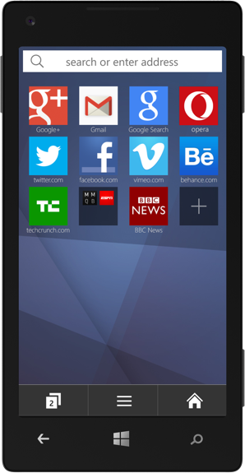
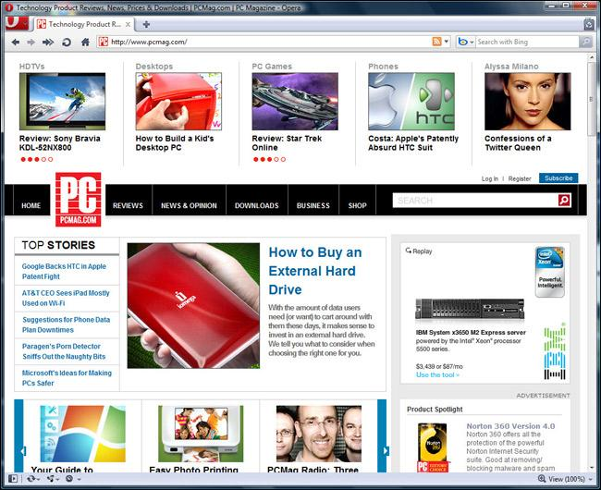
What is the World Wide Web?

Slide 18
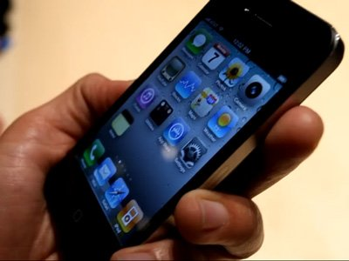
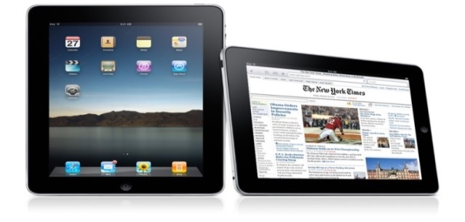
What is the World Wide Web?

Slide 19
How Do People Use the Worlds Wide Web?
Surf
Online Apps
Text Messaging
Email
Netflix
Hulu
Google
Facebook
YouTube
Wikipedia
Amazon
Yahoo
MS Office 365
Skype

Slide 20
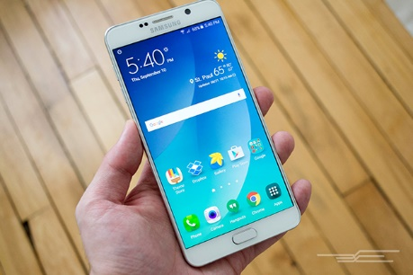
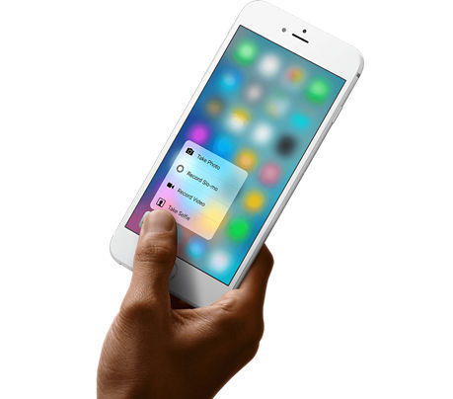
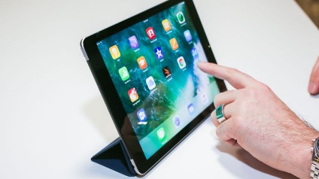
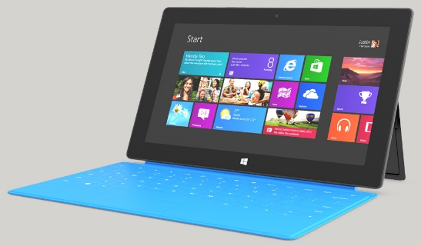
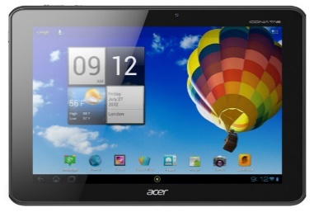
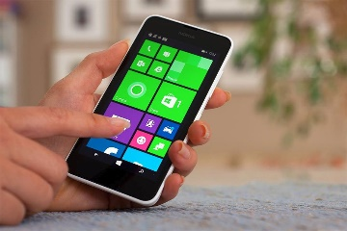
Mobile Telecommunication Devices
Samsung Galaxy
Android Phone
Apple iPhone
Apple iPad
Acer Android Tablet
Windows iPhone
Windows Surface Tablet

Slide 21
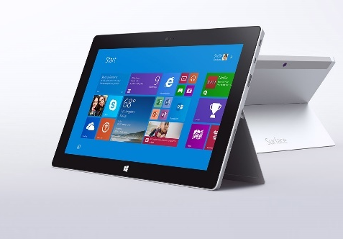
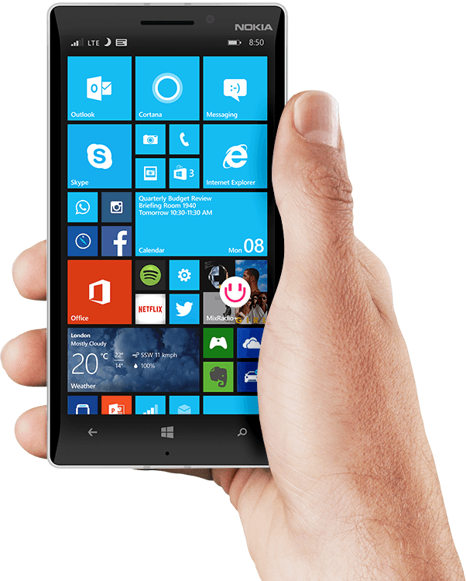
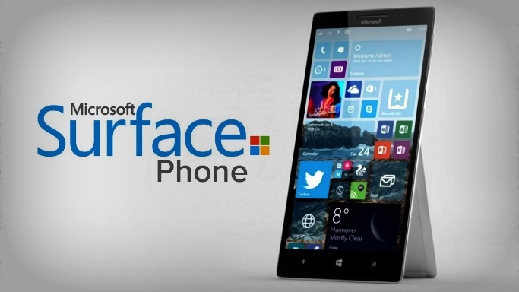
Windows Device Group
Surface Tablet
Windows Phone
Surface Phone (2018)
Windows OS 10

Slide 22
Android Phone
Google Android OS
2016 CNET Best Android Phones
2017 Best Android Phone Apps PC Magazine

Slide 23
Android Tablets
Google Android OS
2017 Best Android Tablets – PC Magazine
2017 Best Android Apps – Android Authority

Slide 24
iPhone
Apple iPhone Models
2017 Best iPhone Apps – PC Magazine

Slide 25
iPad
iPad Models
2017 Best iPad Apps – PC Magazine

Slide 26
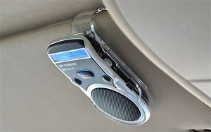
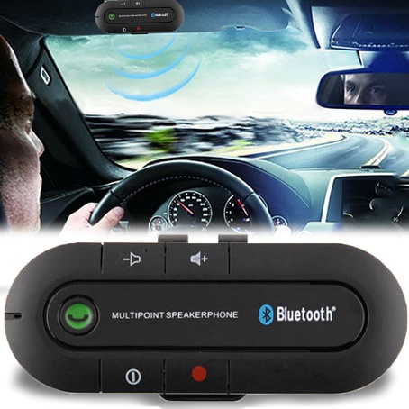
Smartphone Handsfree Capabilities
Bluetooth technology

Slide 27
Student Exercise – Part II
Is you device configured to use the World Wide Web (WWW)?
If So - what Browser do you use?
How does your device manage files?
What apps do you use?

Slide 28
Additional Smartphone Capabilities
Speech to Text
Security Login Text (Banks & Funds)
Wireless Hotspot
Paying with your phone - NFC technology
Scan Barcodes, Find Deals
Mirror
Flashlight
Heart Rate Monitor Beats Per Minute
Location-based reminders

Slide 29
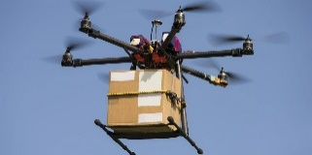
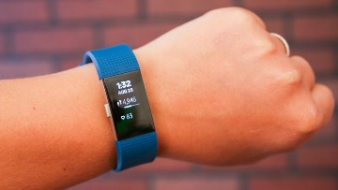
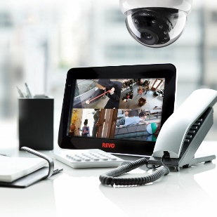
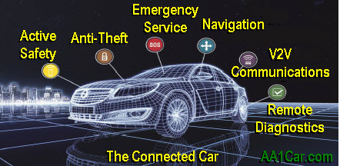
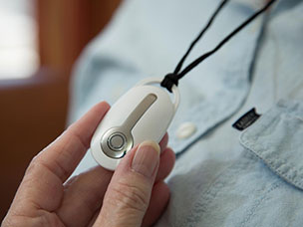
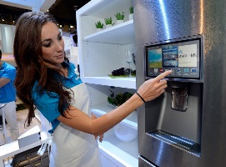
What is the IoT?
Internet of Things

Slide 30
IoT – The New Things on the Internet
Wearable Technology
Activity Trackers
Biotelemetry
Remote Monitoring
Energy management
Environmental monitoring
Building and home automation
Home Appliances
Virtual Assistants
Remote Sensing
RFID - Automatic Identification and Data Capture (AIDC)

Slide 31
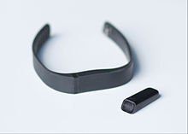
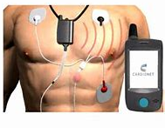
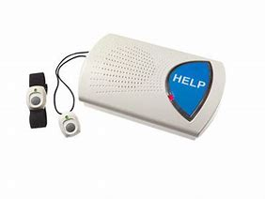
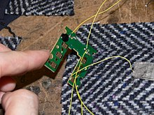
Wearable Technology
Activity Trackers
Biotelemetry
BodyMedia
Valencell
Smart Fabric

Slide 32
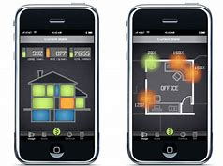
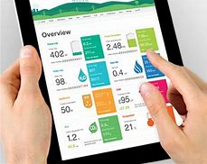
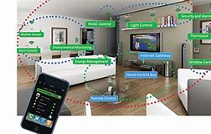
Remote Monitoring
Energy Management
Building and Home Automation
Environmental Monitoring
Home Appliances

Slide 33
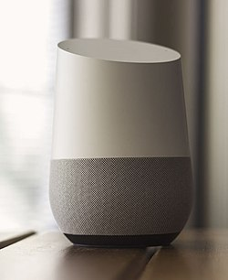
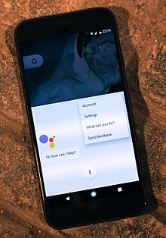
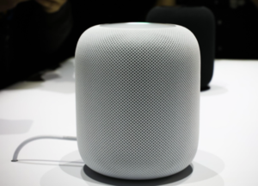
Virtual Assistants
Apple's Siri (34%)
Google Assistant (19%)
Apple HomePod
Google Home
Amazon Alexa (6%)
Amazon
Echo
Microsoft Cortana (4%)

Slide 34
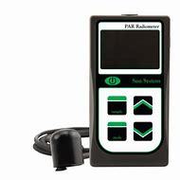
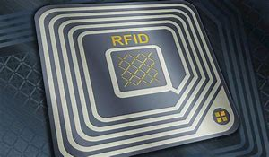
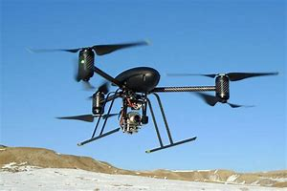
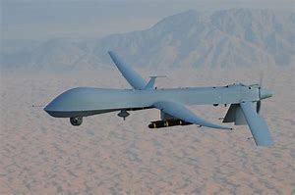
Remote Sensing

Slide 35
Review
Telecommunications, Internet, & World Wide Web
What are Telecommunication Services?
Digital Transformation
What is the Internet?
What is the World Wide Web?
How Do You Use the Worlds Wide Web?
Mobile Telecommunication Devices
Smartphone Capabilities
What is the Internet of Things (IoT)
Next Session – Social Media

