Slide 1
Digital Literacy for the 21st Century
Session II – Digital Computing Devices http://www.profburnett.com

Slide 2
Outline
Technical Terms, Jargon, Acronyms, and Abbreviations
Digital Computing Devices & Networks
What are Digital Computing Devices
What are the Main Components of Digital Computing Devices
What are the Main Components of Computer Hardware
Student Exercise 1
What are the Types of Computer Software
Student Exercise 2
What is a Digital Network
What are the Main Components of a Wired Network
What are the Main Components of a Wireless Network
What is the difference between Telecommunication Wireless and Computer Wireless Networks
Student Exercise 3

Slide 3
Student Questions
Mike Feuerstein
Q1 – How to understand different technologies to use them more effectively. - Session I - VI
Q2 – Learn about the range of digital technologies and what they can do. - Session I - VI
Dennis Thornton
Q1 – Is digital technology the end game? – Session I – VI
Q2 – Difference between WiFi and mobile networks? – Session II & III
Yvette Lamb
Q1 – How is it (possible) that a range of devices (phone, computer, etc.) can connect and “know” how to work together. - Session II & III
Q2 – Is there a key skill to master to understand digital technology? - Session I - VI
Q3 – Will artificial intelligence “replace” human intelligence? - Session I

Slide 4
Student Questions
Ken Lechter
Q1 – What actually happens when you turn on a computer. - Session II
Karen Lechter
Q1 – How do I keep up with all the constant change in the digital world? - Session I - VI
Q2 – Will it become easier to use digital technology in the future or will things change too fast? - Session I - VI
Q3 – Is it hopeless for me to expect to be digitally literate as time goes on? - Session I - VI

Slide 5
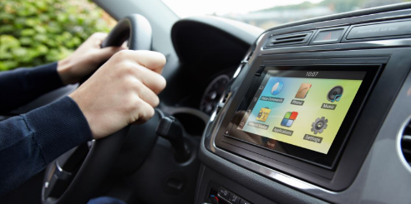
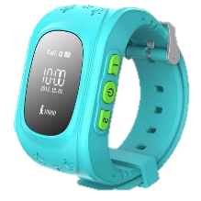
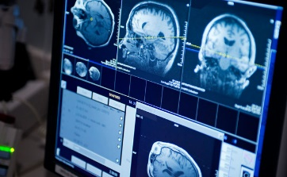
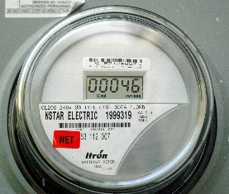
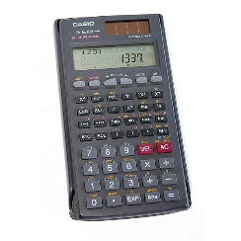
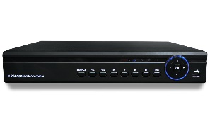
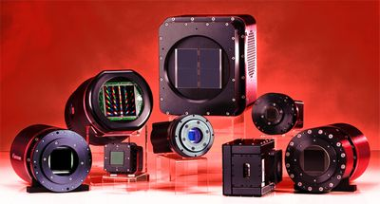
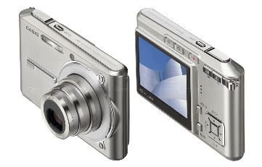
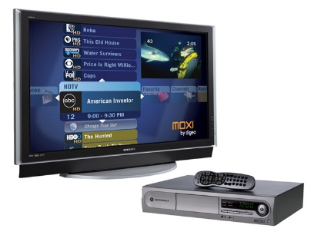
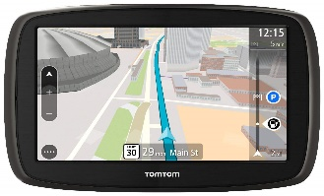
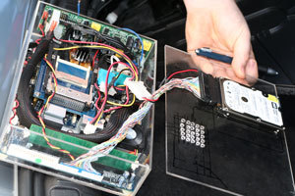
What are Digital Computing Devices?

Slide 6
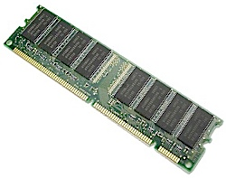
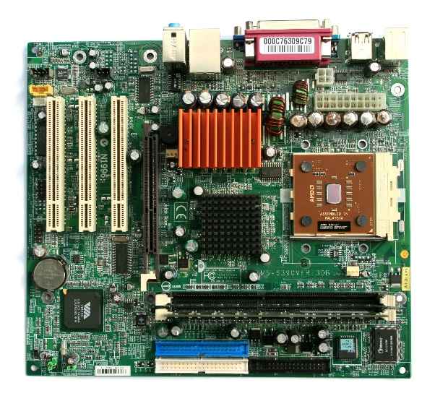
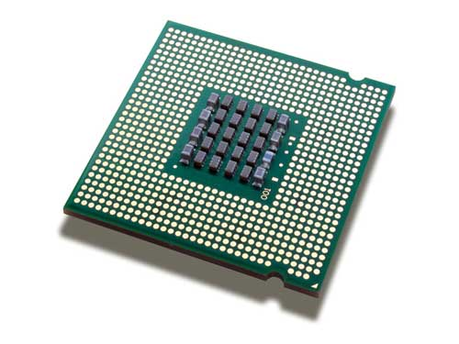
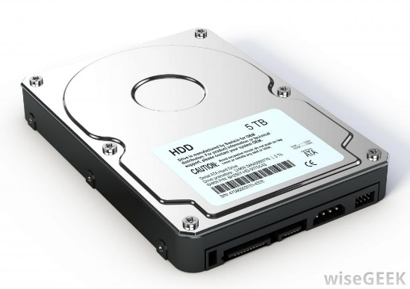
What are the Main Components of Digital Computing Devices?
Random Access Memory
(RAM)
Central Processing Unit
(CPU)
Motherboard
Storage Device

Slide 7
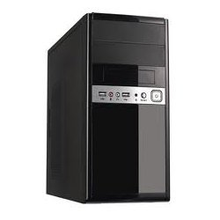
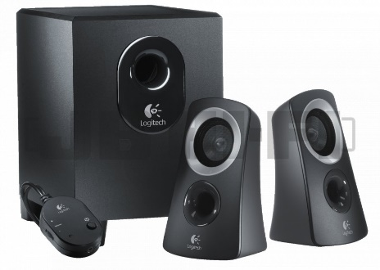
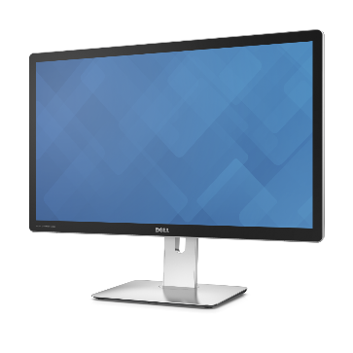
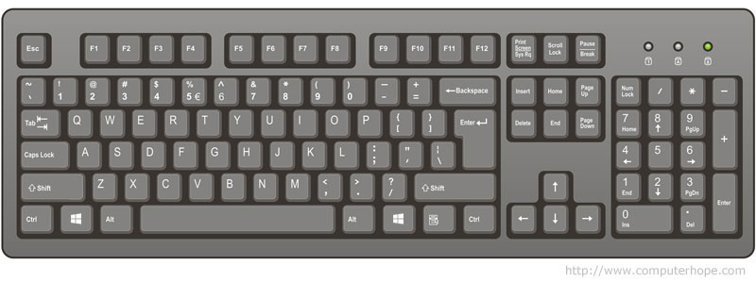
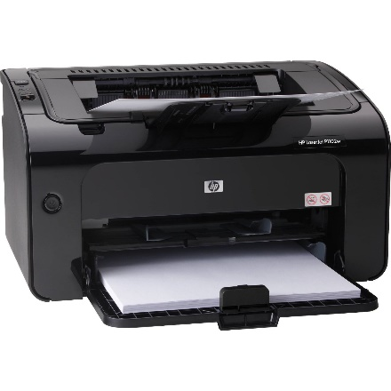
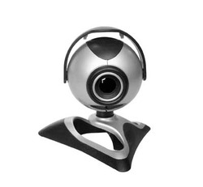
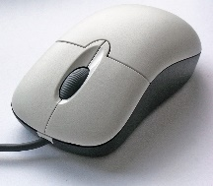
What are the Main Components of Computer Hardware?
Peripherals
Computer Cabinet

Slide 8
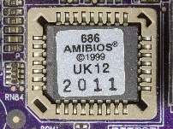
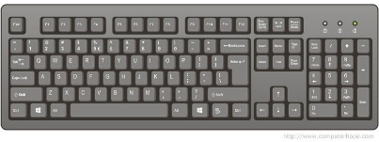
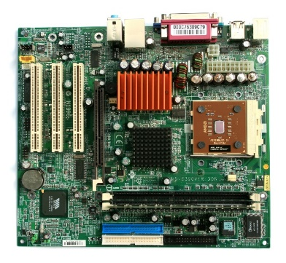
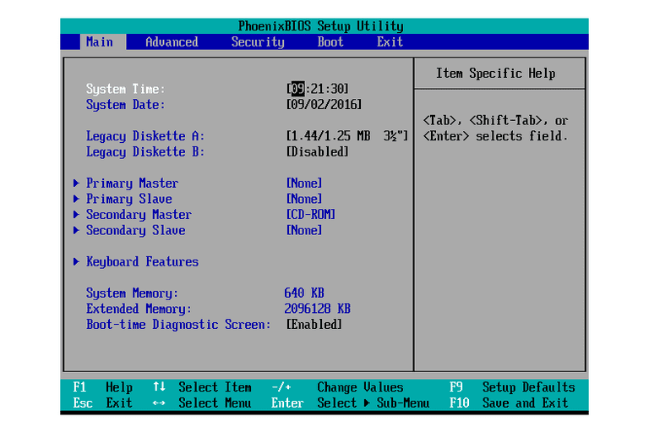
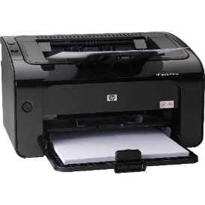
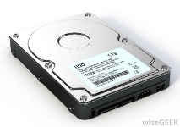
Power On Self Test (POST)
BIOS – Basic Input Output System
ROM – Read Only Memory
Loads the Operation System

Slide 9
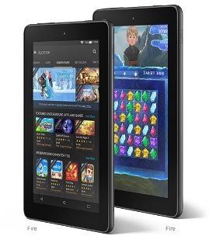
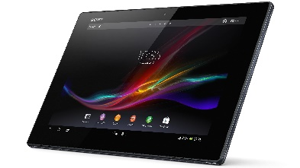
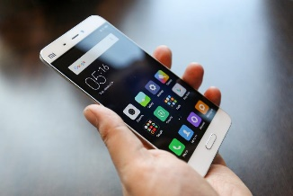
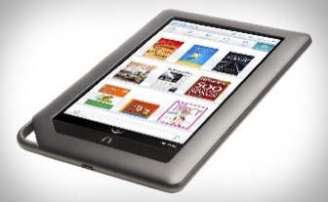
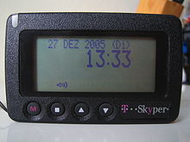
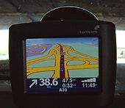
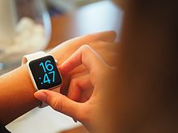
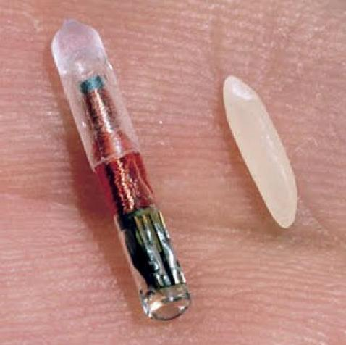
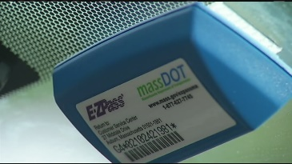
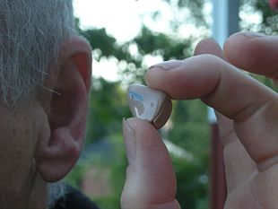
Mobile Computing Devices
Eliot Lieberman – Digital technologies impact on pictures and picture taking in general

Slide 10
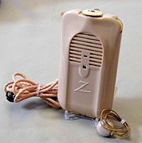
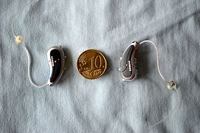
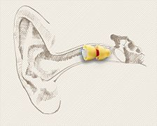
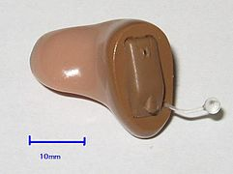
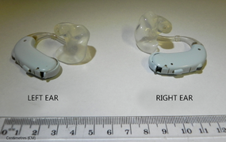
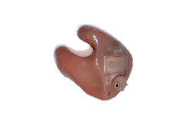
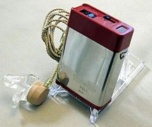
Hearing Instruments
Vacuum Tube (1944)
Receiver-in-the-Canal
In-the-canal
Completely in the canal
In-the-Ear
Bone Anchored
BTE hearing aids
Transistor Body Worn
(1948)
Analog Audio - US Patent 2,017,358 (1932)
Digital Audio - US Patent 4,548,082 (1984)

Slide 11
Student Exercise 1
List all the digital computing devices your interact with daily.
List the main component of your laptop, tablet, or phone. What is the type and version of your devices.
List the peripheral devices of your laptop, tablet, or phone. What is the primary peripheral device of your computing device?
Share your lists with a classmate.

Slide 12
What are the Main Types of Computer Software?
Operating Systems
Application Programs
Utility Programs

Slide 13
Windows Operating Systems
Release Dates | Desktop / Laptop | Tablet | Phone
29 July 2015 | Windows 10 |  | Windows 10 Mobile
26 October 2012 | Windows 8 | Windows RT 8.1 | Windows Phone 8
22 October 2009 | Windows 7 | Windows 7 Starter | Windows Phone 7
30 January 2007 | Windows Vista | Windows Vista Starter | Windows Mobile 6.5
25 April 2005 | Windows XP Professional x64
25 October 2001 | Windows XP | Windows XP Tablet PC Edition
17 February 2000 | Windows 2000 |  | Windows Mobile 2003
25 June 1998 | Windows 98 |  | Pocket PC 2002
24 August 1996 | Windows NT 4.0
24 August 1995 | Windows 95 |  | Pocket PC 2000
November 1993 | Windows for Workgroups 3.11
April 1992 | Windows 3.1
22 May 1990 | Windows 3.0
9 December 1987 | Windows 2.03
20 November 1985 | Windows 1.01

Slide 14
Apple Operating Systems
Release Dates | iMac/MacBook | iPad | iPhone | iPod
September 20, 2016 | macOS 10.12 | 9.3.5 / 10.0.2 | 9.3.5 / 10.0.2 | 9.3.5 / 10.0.2
September 30, 2015 | OS X 10.11
October 16, 2014 | OS X 10.10 |  | 6.1.6 / 7.1.2 | 6.1.6 / 7.1.2
October 22, 2013 | OS X 10.9 | 5.1.1 (2012) |  | 5.1.1 (2012)
July 25, 2012 | OS X 10.8 |  | 4.2.1 | 4.2.1
July 20, 2011 | Mac OS X 10.7 |  | 3.1.3 | 3.1.3
August 28, 2009 | Mac OS X 10.6
October 26, 2007 | Mac OS X 10.5
April 29, 2005 | Mac OS X 10.4
October 24, 2003 | Mac OS X 10.3
August 24, 2002 | Mac OS X 10.2
September 25, 2001 | Mac OS X 10.1
March 24, 2001 | Mac OS X 10.0

Slide 15
Android Operating System
Release Date | Code name | Version number
22 August 2016 | Nougat | 7.0
5 October 2015 | Marshmallow | 6.0 – 6.0.1
12 November 2014 | Lollipop | 5.0 – 5.1.1
31 October 2013 | KitKat | 4.4 – 4.4.4
9 July 2012 | Jelly Bean | 4.1 – 4.3.1
18 October 2011 | Ice Cream Sandwich | 4.0 – 4.0.4
22 February 2011 | Honeycomb | 3.0 – 3.2.6
6 December 2010 | Gingerbread | 2.3 – 2.3.7
20 May 2010 | Froyo | 2.2 – 2.2.3
26 October 2009 | Eclair | 2.0 – 2.1
15 September 2009 | Donut | 1.6
27 April 2009 | Cupcake | 1.5
9 February 2009 |  | 1.1
23 September 2008 |  | 1.0

Slide 16
Major Application Programs
Category | Windows | Apple | Android
Office Productivity | MS Office | MS Office | -
Desktop Publishing | Adobe | Adobe | -
Music | WMP / WMC | iTunes | Poweramp BlackPlayer (Free)
Email | Outlook | Outlook Apple Mail | Outlook Gmail

Slide 17
Utility Programs
 | Windows | Apple | Android
File Management | Windows Explorer (Desktop/Pad) | Finder (Desktop/Pad) | ES File Explorer – $2.99 ASTRO File Manager – Free Solid Explorer – $1.99 File Commander – Free Cheetah Mobile File Manager – Free More
Voice Control | Cortana (Desktop/Pad/Phone) | Siri (Desktop/Pad/Phone) | OK Google Voice Access AutoVoice
Web Browser | Internet Explorer Edge (Desktop/Pad/Phone) | Safari (Desktop/Pad/Phone) | Blink Chrome (Phone)

Slide 18
Student Exercise 2
What is the operating system and version of your computing devices?
PC
Laptop
Tablet
Phone
Watch
Tracker
What are the Utility program you have on your digital devices?
Share your lists with a classmate.

Slide 19
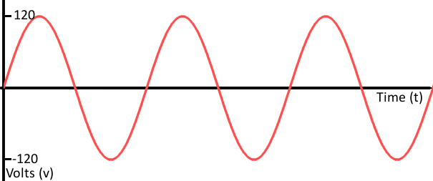
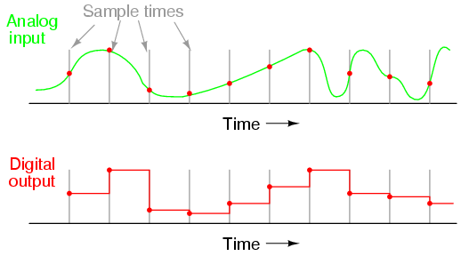
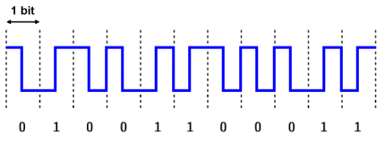
What is a Digital Network?
Analog versus Digital
Telephone Network
Radio Network
Television Network
Mobile Phone Network
Satellite Network

Slide 20
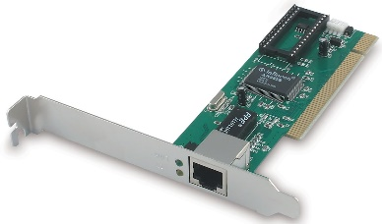
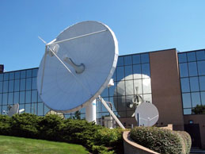
What are the Main Components of a Wired Network?
Network Interface Card (NIC)
Cable
Satellite Uplink
Hub
Router
Switch
FIOS Hub
Cable Hub

Slide 21
What are the Main Components of a Wireless Network?
Wireless Network Interface Card (NIC)
Wireless Router
Satellite Uplink
Hub
Ethernet Cable
Cellphone Tower
Switch

Slide 22
What is the difference between Computer Wireless Network and a Mobile Wireless Network?
Mobile Wireless Network
Computer Wireless Network (WiFi)
Cellphone Tower
Wireless Router
FIOS Hub
Cable Hub

Slide 23
Bluetooth Network
IEEE Standard 802.15.1
Bluetooth 5
Pairing and Bonding
Class 1, industrial use cases 100 meters (300 ft).
Class 2, mobile devices 10 meters (33 ft)
Class 3 radios - 1 meter (3 ft)
Frequency Hopping
Wireless mobile phone and a handsfree headset.
Bluetooth compatible car stereo system.
communication with iOS and Android device phones, tablets and portable wireless speakers.
Wireless streaming of audio to headphones
Wireless streaming of data collected by Bluetooth-enabled fitness devices to phone or PC.^{[27]}
Wireless communication with PC input and output devices mouse, keyboard and printer.
Transfer of files, contact details, calendar appointments, and reminders between devices with OBEX.
GPS receivers, medical equipment, bar code scanners, and traffic control devices.
Wireless bridge between two Industrial Ethernet (e.g., PROFINET) networks.
Seventh and eighth generation game consoles
Short-range transmission of health sensor data from medical devices to mobile phone, set-top box or dedicated telehealth devices.^{[31][32]}
Real-time location systems (RTLS) are used to track and identify the location of objects in real time using "Nodes" or "tags" attached to, or embedded in, the objects tracked, and "Readers" that receive and process the wireless signals from these tags to determine their locations.^{[33]}
Calgary, Alberta, Canada's Roads Traffic division uses data collected from travelers' Bluetooth devices to predict travel times and road congestion for motorists.^{[35]}

Slide 24
Student Exercise 3
Group your devices based on how they connect to a network. (Wired, WiFi, Mobile, Bluetooth)
Share your lists with a classmate.

Slide 25
Review
Digital Computing Devices & Networks
Technical Terms, Jargon, Acronyms, and Abbreviations
Digital Computing Devices & Networks
What are Digital Computing Devices
What are the Main Components of Digital Computing Devices
What are the Main Components of Computer Hardware
Student Exercise 1
What are the Types of Computer Software
Student Exercise 2
What is a Digital Network
What are the Main Components of a Wired Network
What are the Main Components of a Wireless Network
What is the difference between Telecommunication Wireless and Computer Wireless Networks
Student Exercise 3
Next Session – Telecommunications, Internet, & World Wide Web

