Slide 1
MS Project 2016 Level II
http://www.profburnett.com

Slide 2
Outline
Introductions
Class Outline
Review Class Website

Slide 3
Instructor Info
Carl Burnett
Instructor with MCC since 2007
Also teaches at JHU & CTC
Military 22 Years – Corps of Engineers
IT Contractor 20 Years (BAH, GD, Independent)
profburnett@live.com
carl.burnett@montgomerycollege.edu
240.696.1906

Slide 4
Introductions
Name
Job
What do you to expect from course?

Slide 5
Class Website
Class Website
Download Class Files
Bring in a Project to Manage

Slide 6
Course Outline
Session I
Lesson 1 – Advanced task scheduling
Lesson 2 - Fine-tuning task details
Lesson 3 - Fine-tuning resource and assignment details
Lesson 4 - Fine-tuning the Project plan
Lesson 5 - Organizing project details
Session II
Lesson 6 - Tracking progress on tasks and assignments
Lesson 7 - Viewing and reporting project status
Lesson 8 – Advanced formatting, printing and report formatting
Lesson 9 – Customizing, Sharing and Consolidating Projects

Slide 7
Session I
Lesson 1 – Advanced task scheduling
Lesson 2 - Fine-tuning task details
Lesson 3 - Fine-tuning resource and assignment details
Lesson 4 - Fine-tuning the Project plan
Lesson 5 - Organizing project details

Slide 8
Lesson 1 – Advanced Task Scheduling
Task Path Relationship
Task Relationships
Task Constraints
Task Duration Types
Task Duration Calculations
Task Inspector

Slide 9
Task Path Relationship
Predecessors
Driving Predecessors
Successors
Driving Successors

Slide 10
Task Relationships
Finish-to-Start (FS)
Finish-to-Finish (FF)
Start-to-Start (SS)
Start-to-Finish (SF)

Slide 11
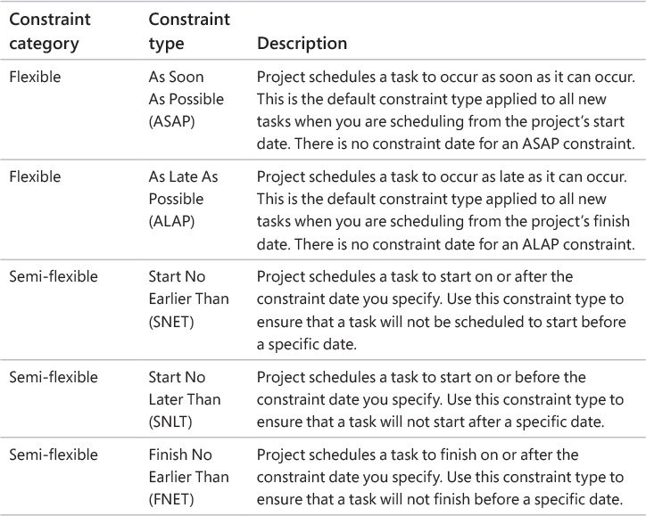
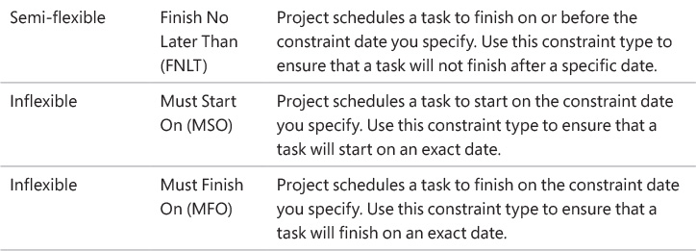
Task Constraints

Slide 12
Task Duration Calculations

Slide 13
Lesson 2 - Fine-tuning Task Details
Enter deadline dates
Enter fixed costs
Create a recurring task
View the plan’s critical path
Schedule summary tasks manually

Slide 14
Fixed Costs
Start of Task
End of Task
Prorated (Default)

Slide 15
Lesson 3 - Fine-tuning Resource and Assignment Details
Change resource availability over multiple date ranges
Work with multiple resource pay rates
Change resource pay rates over different date ranges
Delay the start of assignments
Apply contours to assignments
Create and assign material resources
View resource capacity
Adjust assignments in the Team Planner view (Project Professional only)

Slide 16
Assignments Contours
Flat
Back-loaded
Front-loaded
Double peak
Early peak
Late peak
Bell
Turtle

Slide 17
Lesson 4 - Fine-tuning the Project Plan
Examine resource allocations over time
Resolve resource overallocations manually
Level overallocated resources
Check the plan’s cost and finish date
Inactivate tasks (Project Professional only)

Slide 18
Lesson 5 - Organizing Project Details
Sort plan details
Group plan details
Filter plan details
Create new tables
Create new views

Slide 19
Session II
Lesson 6 - Tracking progress on tasks and assignments
Lesson 7 - Viewing and reporting project status
Lesson 8 – Advanced formatting, printing and report formatting
Lesson 9 – Customizing, Sharing and Consolidating Projects

Slide 20
Lesson 6 - Tracking Progress on Tasks and Assignments
Update a baseline
Track actual and remaining work for tasks and assignments
Track timephased actual work for tasks and assignments
Reschedule incomplete work

Slide 21
Lesson 7 - Viewing and Reporting Project Status
Examine a plan’s variance
Identify tasks that have slipped
Examine task costs
Examine resource costs

Slide 22
Lesson 8 – Advanced Formatting, Printing and Report Formatting
Format a Gantt chart view
Format a Timeline view
Format a Network Diagram view
Format a Calendar view
Print and export views
Create a custom report
Customize charts in a report
Customize tables in a report

Slide 23
Lesson 9 – Customizing, Sharing and Consolidating Projects
Share custom elements between plans
Record and run macros
Edit macros
Customize the ribbon and Quick Access Toolbar
Copy Project data to and from other programs
Open files in other formats in Project
Save to other file formats from Project
Generate reports with Excel and Visio
Share a resource pool across multiple plans
Consolidate plans
Create dependencies between plans

Slide 24
Class Evaluation
WD&CE Course Evaluation Form
http://webdb.montgomerycollege.edu/internet/wdceevals/wdceevals.cfm
Course Name: MS Project 2016 – Level II
Course CRN: 25388
Course Start Date: October 11, 2016
Course Instructor: Carl Burnett

