Slide 1
Monitoring and Reporting Project Progress
http://www.profburnett.com

Slide 2
Outline
Control versus Risk
Control versus Quality
Progress Reporting System
Applying Graphical Reporting Tools
Deciding on Report Level of Detail
Managing Project Status Meetings
Managing Change
Change Control and the Project Life Cycles
Managing Problem Escalation

Slide 3
Control versus Risk
Controls: “Actions taken as a result of reports.”
Purpose of Controls
To track progress
To detect variance from plan
To take corrective action
High Control – Low Risk
Low Control – High Risk

Slide 4
Balancing the Control System
Point of Diminishing Returns
Excessive Control Can Limit Creativity
Excessive Control Can Increase Reporting Overhead
$
Total Cost
Control
Risk

Slide 5
Control versus Quality
Positive Correlation between Control and Quality

Slide 6
Progress Reporting System
Characteristics of a good reporting system
Timely, complete, and accurate status information
Minimizes overhead needed for reporting
Readily acceptable to project team and senior management
Early warning of pending problems
Easily understood
Types of Project Status Reports
Current Period Reports
Cumulative Reports
Exception Reports
Stoplight Reports
Variance Reports

Slide 7
Variance Reports
Report has three columns
The planned number
The actual number
The difference between the two numbers
Report can be numeric or graphical
Five Reasons to report on duration and cost variances
Catch deviations from the curve early
Dampen oscillation
Allow early corrective action
Determine weekly schedule variance
Determine weekly effort (person hours/days) variance

Slide 8
How and What Information to Update
Determine a set period of time and day of week
Report actual work accomplished during this period
Report start and finish dates
Record days of duration accomplished and remaining
Report resource effort (hours/day) spent and remaining (in-progress work only)
Report percent complete
Frequency of gathering and reporting project progress
Typically weekly but can be more or less frequent depending on the project

Slide 9
Variances
Positive
Indicates ahead of schedule or less cost than planned
May not always be good
Negative
Indicates behind schedule or more cost than planned
May not always be bad

Slide 10
Gantt Charts

Slide 11
Milestone Trend Charts
Successive Slippages
Early
3
2
1
On Schedule
●
●
●
●
1
●
●
●
2
●
3
Late
Notes:
●

Slide 12
Milestone Trend Charts
Radical Change
Early
3
●
2
1
On Schedule
●
●
●
●
1
●
2
3
Late

Slide 13
Milestone Trend Charts
Schedule Shift
●
●
Early
3
2
1
On Schedule
●
●
●
●
1
2
3
Late

Slide 14
Milestone Trend Charts
Successive Runs
Early
3
2
●
●
●
1
●
●
●
●
On Schedule
●
1
2
3
Late

Slide 15
Earned Value Analysis
Measures project performance in dollar values
Baseline
Baseline
Progress
Progress
Cost Variance
Cost Variance
Schedule Variance
Actual
Update Date
Actual
Update Date
Time
Time

Slide 16
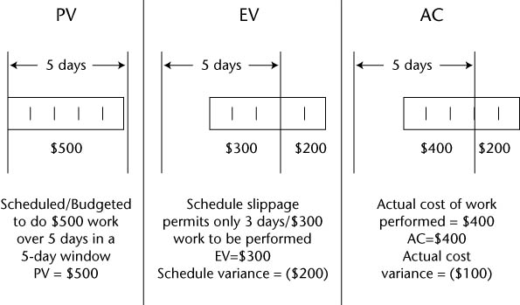
Earned Value Analysis (Cont.)

Slide 17
Earned Value Analysis (Cont.)
Schedule Variance
Progress
Progress
Estimate to Complete
PV
PV
AC
Cost Variance
AC
Baseline
Finish
Date
EV
Update Date
EV
Update Date
Time
Time

Slide 18
Earned Value Analysis (Cont.)
Schedule Performance Index
SPI = EV / PV
Cost Performance Index
CPI = EV / AC

Slide 19
Deciding on the Report Level of Detail
Activity Manager
Most detailed and granular information
Project Manager
Most detailed and granular information
Emphasis on schedule and budget
Senior Management
Graphical
Milestone-level or summary-level

Slide 20
Managing Project Status Meetings
Who should attend?
Determine if some attendees just need information and that the meeting minutes will suffice
If two or more members need to discuss a tangential issue, then consider using a sidebar meeting
When are they held?
Weekly
On a regular basis
What is their purpose?
To encourage the free flow of information
Format
Top-down (project champion, customer, project manager, and so on)
Record minutes

Slide 21
Managing Change
Two essential documents to the change management process
Project Change Request
Project Impact Statement
Six possible outcomes from a change request
It can be accommodated within the project resources and timelines
It can be accommodated but will require an extension of the deliverable schedule
It can be accommodated within the current deliverable schedule, but additional resources will be needed
It can be accommodated, but additional resources and an extension of the deliverable schedule will be required
It can be accommodated with a multiple release strategy and prioritizing of the deliverables across the release date
It cannot be accommodated without a significant change to the project

Slide 22
A Typical Change Control Process

Slide 23
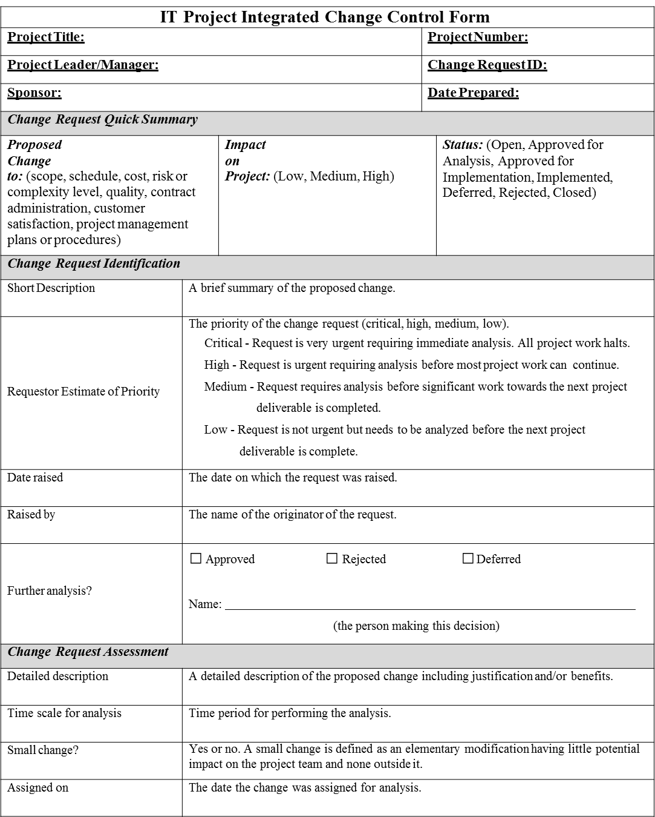
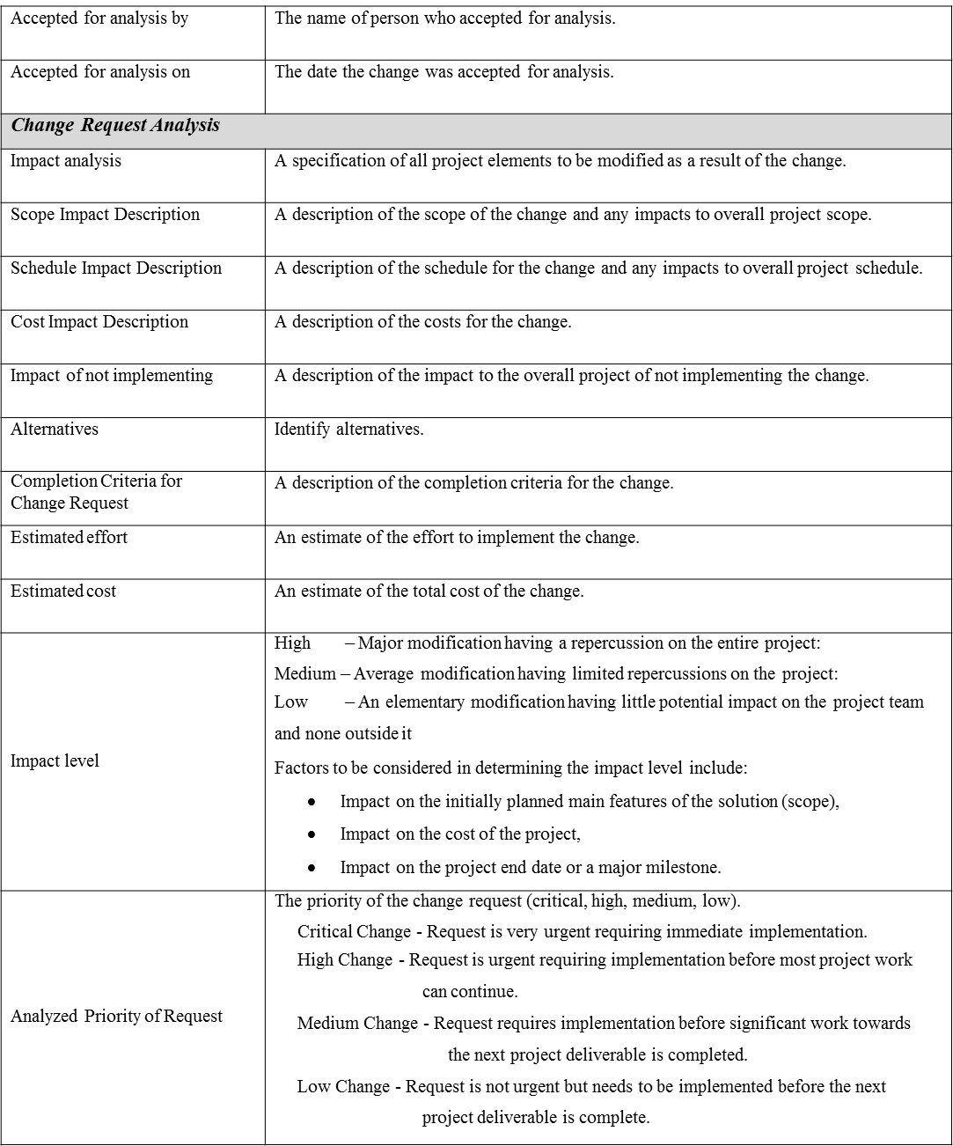
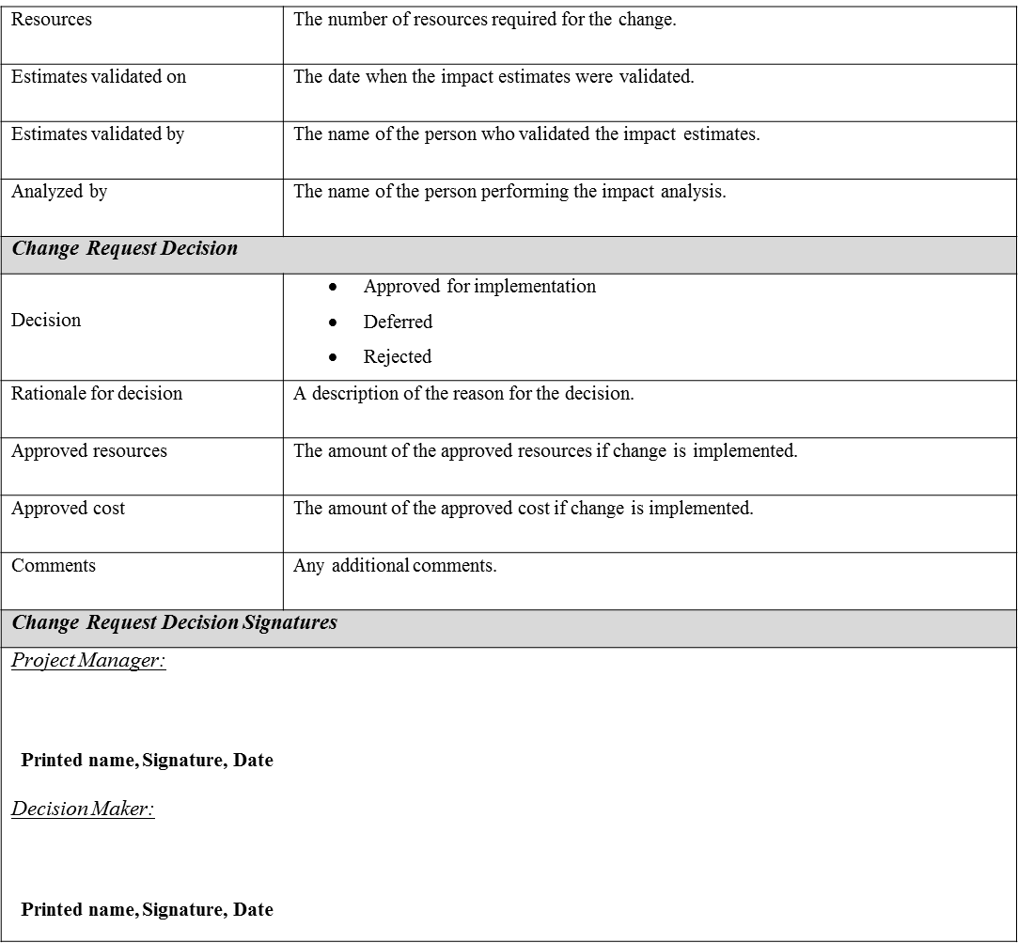
Change Control Form

Slide 24
Change Control and Project Management Approaches
Linear Approaches
Most resistant to change
Too many change requests can severely impact the project
Incremental Approaches
Can handle some change between increments
Iterative Approaches
Better designed to handle change requests
Schedule and budget contingencies to handle change
Adaptive Approaches
Change is required in this approach as the way to refine customer expectations
Extreme Approaches
Built on constant change

Slide 25
Managing Problem Escalation
Project manager-based strategies
Non-critical path: use free float
Schedule compression
Reassign resources
Resource manager-based strategies
Ask for additional resources
Shift resources from later in the project to current needs
Customer-based strategies
Consider multiple-release strategies
Ask for a time extension

Slide 26
Problem Management Meetings
Provide an oversight function to identify, monitor, and resolve problems
Problem is identified in status meeting
Ad-hoc group is formed to handle problem
Progress reports are presented at problem status meetings
Group is disbanded once problem is resolved
Solution is documented

Slide 27
Review
Control versus Risk
Control versus Quality
Progress Reporting System
Applying Graphical Reporting Tools
Deciding on Report Level of Detail
Managing Project Status Meetings
Managing Change
Change Control and the Project Life Cycles
Managing Problem Escalation

