Slide 1
MS Excel 2016 Level III
http://www.profburnett.com

Slide 2
Outline
Introductions
Class Outline
Review Class Website

Slide 3
Instructor Info
Carl Burnett
Instructor with MCC since 2007
Military – Corps of Engineers
IT Contractor - BAH, GD, Independent
profburnett@live.com
carl.burnett@montgomerycollege.edu
240.696.1906

Slide 4
Introductions
Name
Job
What do you to expect from the course?

Slide 5
Class Website
Class Website
Download Student Data Files

Slide 6
Excel 2016 Level III - Course Outline
Session I
Chapter 1: Logical and Lookup Functions
Chapter 2: Advanced Formulas
Chapter 3: Special functions
Session II
Chapter 4: Importing and Exporting
Chapter 5: Analysis
Chapter 6: Macros and Forms

Slide 7
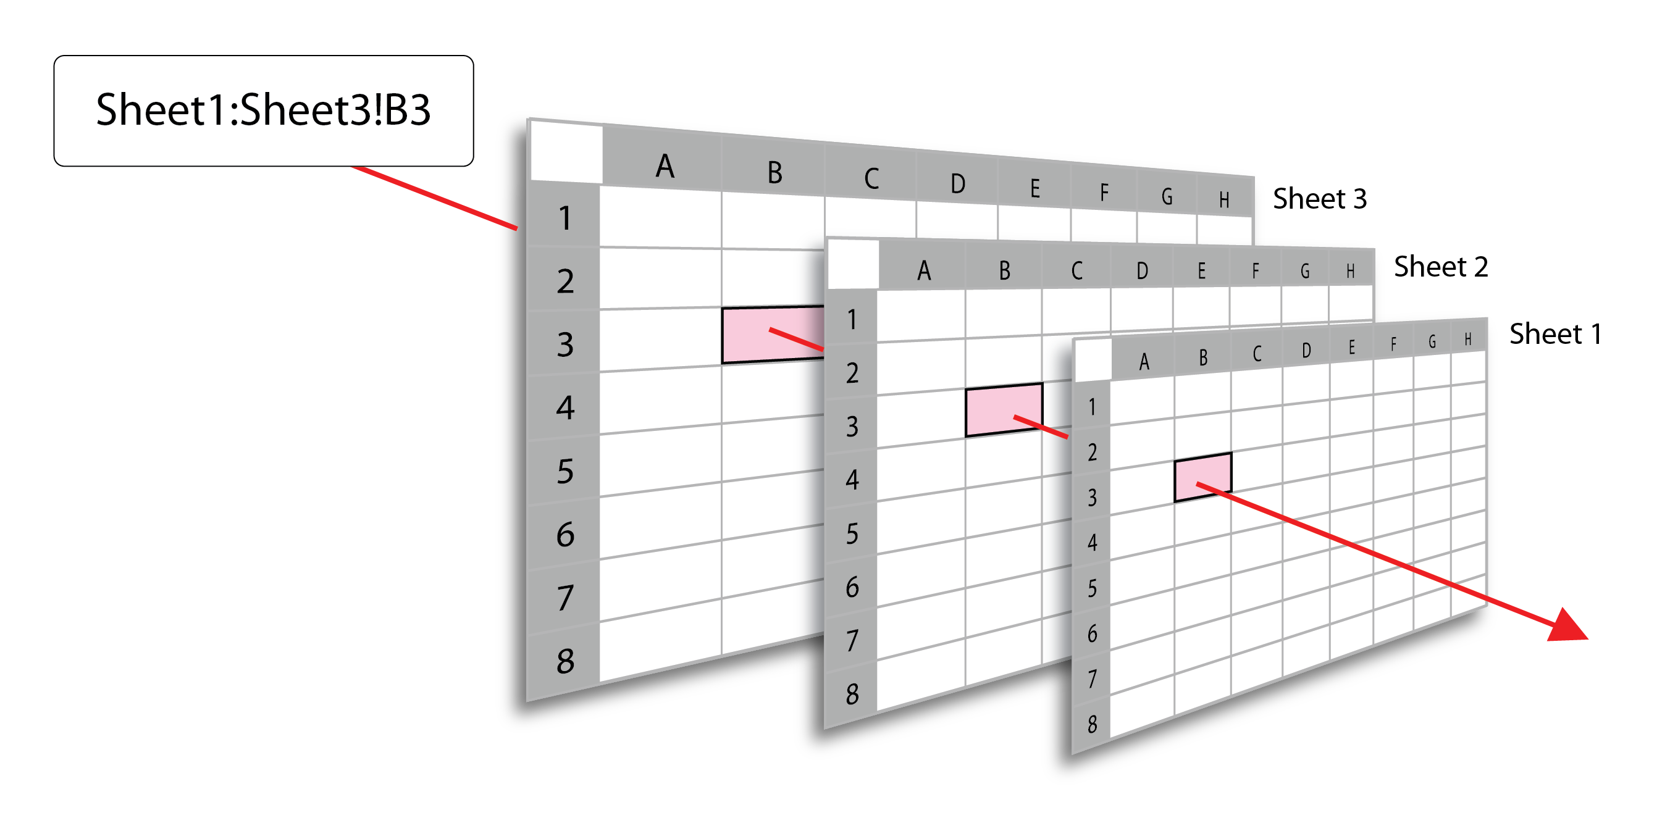
3-D References

Slide 8
The HLOOKUP function
HLOOKUP(lookup_value, table_array,row_index_num,range_lookup)
Syntax
lookup_value = First row of table
table_array = Table Range
row_index_num = number of row value returned
range_lookup = Optional (True or False) true = exact match
If the lookup value is less than the smallest value in the table, an error (#N/A) is returned

Slide 9
The VLOOKUP function
VLOOKUP(lookup_value, table_array,col_index_num,range_lookup)
Syntax
lookup_value = First column of table
table_array = Table Range
row_index_num = number of column value returned
range_lookup = Optional (True or False) true = exact match
If the lookup value is less than the smallest value in the table, an error (#N/A) is returned

