Slide 1
Setting Up Your Development Environment
http://www.profburnett.com

Slide 2
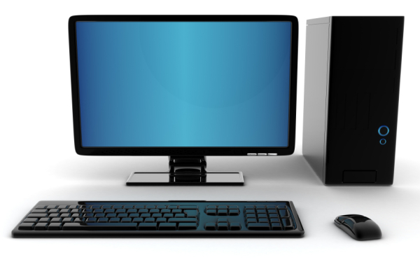
Development Environment
Web
Hosting
Company
Remote
Storage
Test Site
GBTC Storage
Client Computer
Developmental
Sites
Local Storage
Hard Drive in Computer
or
USB Memory Stick
Live Web Site
Web4students Website (Remote Server)

Slide 3
Dreamweaver Development Environment
Remote
Storage
Client Computer
Student Name: (Your Name)
Dreamweaver Local Development Environment Folder:
Site Name: (Your Name)
Local Folder: \\network\pdrive\public\ITI 133 HTML5 Level I\ (Your Name)
Live Web Site
Web4students Website (Remote Server)

Slide 4
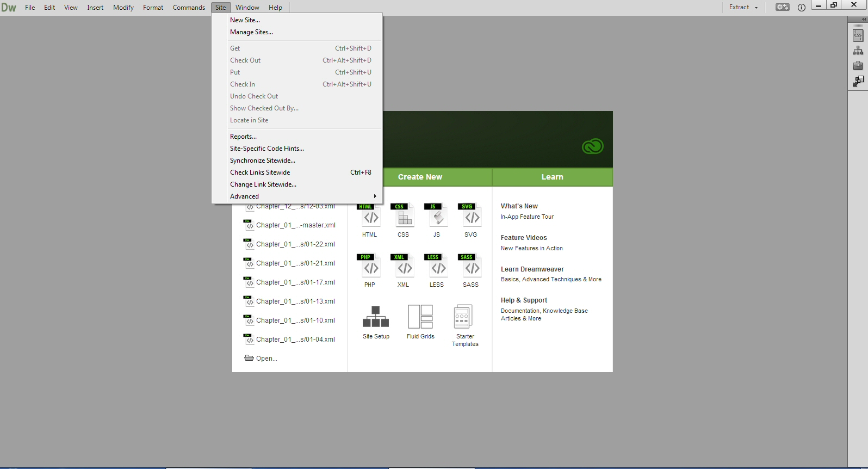

Slide 5
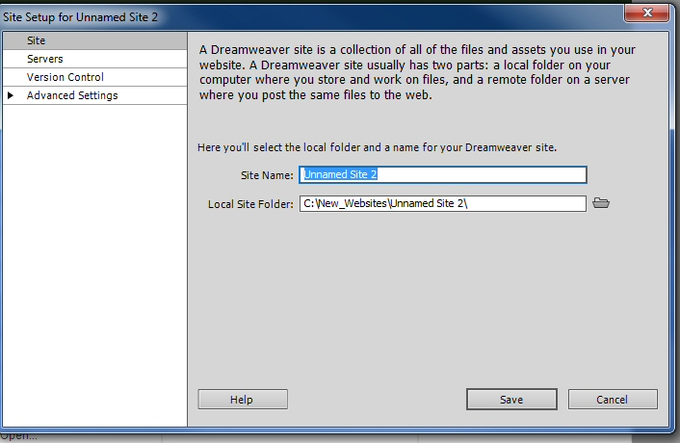

Slide 6
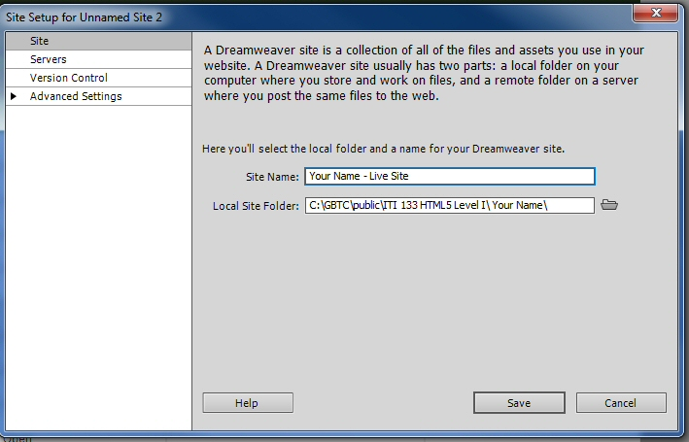

Slide 7
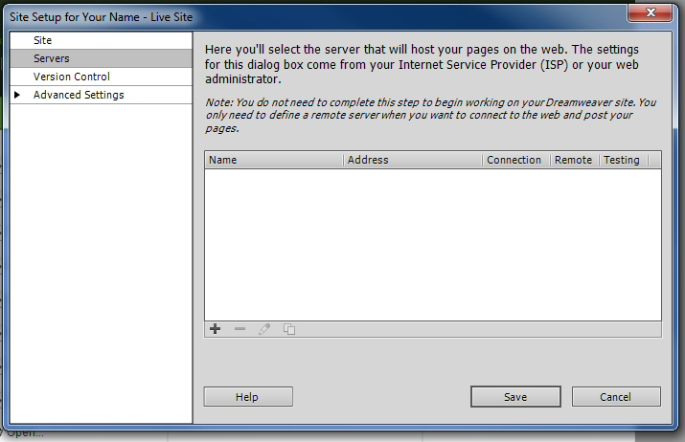

Slide 8
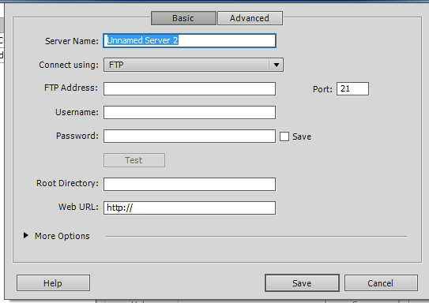

Slide 9
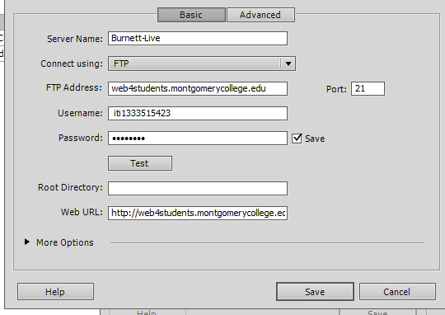

Slide 10
Dreamweaver Development Environment
Remote
Storage
Client Computer
Dreamweaver Live Site Setup Information
Server Name: {Your Last Name_Live}
Connect Using: FTP
FTP Address: web4students.montgomerycollege.edu
Username: iti13335154XX
Password: (Password)
Root Directory: [BLANK]
Web URL: http://web4students.montgomerycollege.edu/
This should be selected as your remote server.
Live Web Site
Web4students Website (Remote Server)

Slide 11
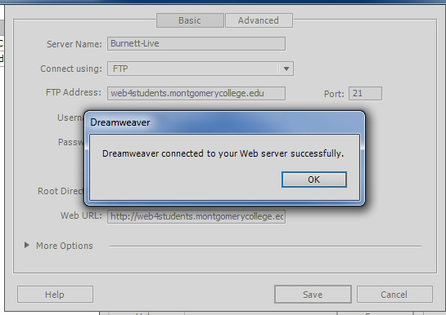

Slide 12
