Slide 1
HTML5 Level II
Session V
Chapter 8 - How to Use Responsive Web Design (RWD)
www.profburnett.com

Slide 2
Class Outline
Introduction to Responsive Web Design (RWD)
Fluid Design
CSS3 Media Queries

Slide 3
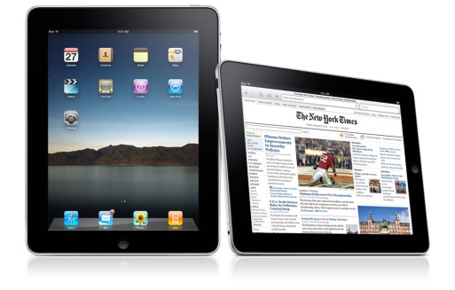
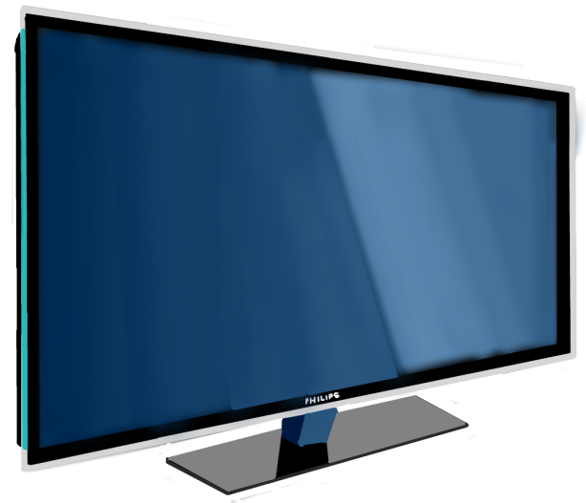
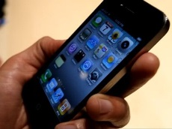
Responsive Web Design (RWD)
Media queries allow the page to use different CSS style rules based on characteristics of the device the site is being displayed on, most commonly the width of the browser.

Slide 4
Flexible Layouts
Relative Viewport Lengths
vw - Viewports width
vh - Viewports height
vmin - Minimum of the viewport’s height and width
vmax - Maximum of the viewport’s height and width

Slide 5
Flexible Grid
CSS
HTML
.container {
width: 538px;
}
section,
aside {
margin: 10px;
}
section {
float: left;
width: 340px;
}
aside {
float: right;
width: 158px;
}
<div class="container">
<section>...</section>
<aside>...</aside>
</div>

Slide 6
Flexible Grid
CSS
.container {
width: 538px;
}
section,
aside {
margin: 10px;
}
section {
float: left;
width: 340px;
}
aside {
float: right;
width: 158px;
}
section,
aside {
margin: 1.858736059%; /* 10px ÷ 538px = .018587361 */
}
section {
float: left;
width: 63.197026%; /* 340px ÷ 538px = .63197026 */
}
aside {
float: right;
width: 29.3680297%; /* 158px ÷ 538px = .293680297 */
}

Slide 7
Media Queries
Initializing Media Queries
Logical Operators in Media Queries
Media Features in Media Queries
Ref: http://learn.shayhowe.com/advanced-html-css/responsive-web-design/#media-queries

Slide 8
Mobile First
Mobile First Demo
Ref: http://learn.shayhowe.com/advanced-html-css/responsive-web-design/#mobile-first

Slide 9
Viewport
Viewport Height & Width
Viewport Scale
Viewport Resolution
Combining Viewport Values
Ref: http://learn.shayhowe.com/advanced-html-css/responsive-web-design/#viewport

Slide 10
Flexible Media
Flexible Media Demo
Flexible Embedded Media
Flexible Embedded Media Demo
Ref: http://learn.shayhowe.com/advanced-html-css/responsive-web-design/#flexible-media

Slide 11
Student Exercise 1
Complete Exercise 8-1 on page 315 using Dreamweaver.
Upload your HTML pages and CSS files to the live site to preview.

Slide 12
Class Review
Introduction to Responsive Web Design (RWD)
Fluid Design
CSS3 Media Queries
That’s All Folks!

