Slide 1
Microsoft Excel 2013
Level III – Advanced
www.profburnett.com

Slide 2
Outline
Introductions
Class Outline
Review Class Website

Slide 3
Instructor Info
Carl Burnett
Instructor with MCC since 2007
Also teaches at JHU & CTC
Military 22 Years – Corps of Engineers
IT Contractor 20 Years (BAH, GD, Independent)
profburnett@live.com
carl.burnett@montgomerycollege.edu
240.696.1906

Slide 4
Introductions
Name
Job
What do you to expect from the course?

Slide 5
Class Website
Class Website
Download Student Class Files
CertBlaster Software

Slide 6
Course Outline
Day 1
Unit 1: Advanced Functions and Formulas
Unit 2: Lookups and Data Tables
Unit 3: Advanced Data Management
Unit 4: Advanced Charting
Unit 5: PivotTables and PivotCharts
Day 2
Unit 6: Exporting and Importing
Unit 7: Analytical Tools
Unit 8: Macros and Custom Functions
Unit 9: Accessibility and Language Features

Slide 7
Unit 1: Advanced Functions and Formulas
Topic A: Logical Functions
Topic B: Conditional Functions
Topic C: Financial Functions
Topic D: Text Functions
Topic E: Data and Time Functions
Topic F: Array Functions
Topic G: Calculation Options

Slide 8
Logical “IF” Functions
IF
AND
OR
NOT
IFERROR

Slide 9
The IF function
IF(logical_test, value_if_true,value_if_false)

Slide 10
AND, OR, and NOT functions
IF(AND(logical1, logical2), value_if_true, value_if_false)
IF(OR(logical1, logical2), value_if_true, value_if_false)
IF(NOT(logical),value_if true, value_if_false)

Slide 11
Nested IF functions
Use the nested IF function to evaluate multiple conditions
Example: Use a second IF function as the value_if_false argument for the first IF function

Slide 12
The IFERROR function
IFERROR(value,value_if_error)

Slide 13
Math & Statistical Functions
SUMIF
COUNTIF
AVERAGEIF
SUMIFS
COUNTIFS
AVERAGEIFS
ROUND

Slide 14
The SUMIF function
SUMIF(range,criteria, sum_range)

Slide 15
The COUNTIF function
COUNTIF(range,criteria)

Slide 16
The AVERAGEIF function
AVERAGEIF(range,criteria, average_range)

Slide 17
SUMIFS, COUNTIFS, AVERAGEIFS
SUMIFS(sum_range, criteria_range1,criteria1, criteria_range2,criteria2)
COUNTIFS(range1,criteria1, range2,criteria2)
AVERAGEIFS(average_range, criteria_range1,criteria1, criteria_range2,criteria2)

Slide 18
The ROUND function
ROUND(value,num_digits)

Slide 19
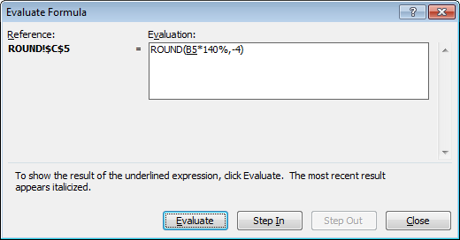
Evaluate Formula dialog box

Slide 20
Financial Functions
PMT - Calculates the payment for a loan based on constant payments and a constant interest rate.

Slide 21
The PMT function
PMT(rate,nper,pv,fv,type)
rate = The interest rate for the loan.
nper = The total number of payments for the loan.
pv = The present value
Fv = The future value
Type = Optional. The number 0 (zero) or 1 and indicates when payments are due

Slide 22
Date Functions
TODAY = Current Date
YEAR = Year in specified date serial number
DAY360 = Calculate between dates
NETWORKDAYS = Calculate work days between dates

Slide 23
Date functions
Various built-in date functions can be used to insert dates or perform date calculations
To insert a date function:
On the Formulas tab, in the Function Library group, click Date & Time and select the desired function
Click the Insert Function button to open the Insert Function dialog box

Slide 24
Array Function
Multiple Calculations on one or more set of values.
Consistency
Editing Safeguards
Reduced File Size

Slide 25
Calculating time
To find the difference between a start time and an end time, use a basic subtraction formula =end_time-start_time
Format the cell as Number or General to see the difference in hours
If formatted as Time, the result will be displayed as hh:mm:ss

Slide 26
Array formulas
Syntax is the same as for any other Excel formula
Start with = and use built-in functions
Must press Ctrl+Shift+Enter to enter the array formula
Array formulas are enclosed in braces: {}
You cannot manually enter the braces to create an array formula

Slide 27
Modify an array formula
Select the cell containing the array formula to be modified
Press F2
Edit the cell references as needed
Press Ctrl+Shift+Enter

Slide 28
Displaying formulas in cells
On the Formulas tab, click Show Formulas
Press Ctrl +` (grave accent)
When formulas are shown in the worksheet, they will print that way

Slide 29
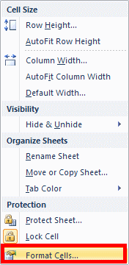
Hide Formulas From Users
Select the cell > On the Home tab, click Format and choose Format Cells

Slide 30
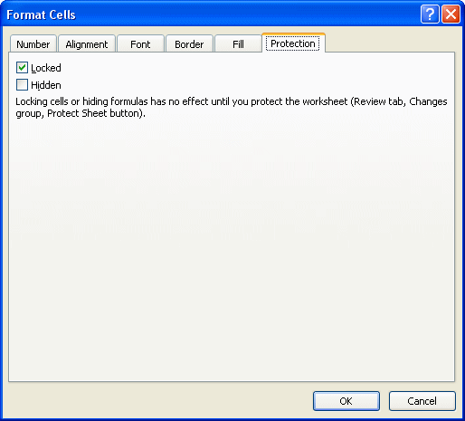
Hide Formulas From Users
Click the Protection tab, check Hidden, and click OK
Click Format and choose Protect Sheet
Ensure that “Protect worksheet and contents of locked cells” is checked
Click OK

Slide 31
Show Formulas
Control + ` Keys
Formula Tab > Formula Auditing Section > Show Formula

Slide 32
Show hidden formulas
Review tab > Unprotect Sheet
Select the range of cells whose formulas you want to unhide
Home tab > Format and choose Format Cells
Protection tab, clear the Hidden checkbox

Slide 33
Automatic recalculation
Disable automatic recalculation in the Excel Options dialog box - Formulas category > Calculation - select Manual
Press F9 or click Calculate Now to manually calculate formulas

Slide 34
Edit iteration calculation options
Excel Options > Formulas
Under Calculation > Enable iterative calculation
Specify the maximum number of iterations allowed
Specify the acceptable amount of change between calculations

Slide 35
Unit 2: Lookups and data tables
Topic A: Using lookup functions
Topic B: Creating data tables

Slide 36
The HLOOKUP function
HLOOKUP(lookup_value, table_array,row_index_num, range_lookup)
Syntax
lookup_value = First row of table
table_array = Table Range
row_index_num = number of row value returned
range_lookup = Optional (True or False) true = exact match
If the lookup value is less than the smallest value in the table, an error (#N/A) is returned

Slide 37
The VLOOKUP function
VLOOKUP(lookup_value, table_array,col_index_num, range_lookup)
Syntax
lookup_value = First column of table
table_array = Table Range
row_index_num = number of column value returned
range_lookup = Optional (True or False) true = exact match
If the lookup value is less than the smallest value in the table, an error (#N/A) is returned

Slide 38
Unit 3: Advanced data management
Topic A: Validating cell entries
Topic B: Exploring database functions

Slide 39
Data Validation
Ensures data matches a specified format
Prompts users with input message
Displays specific error message
Circles invalid entries in the worksheet

Slide 40
Set Data Validation Rules
Select the cells for which you want to create a validation rule
On the Data tab, click Data Validation
Click the Settings tab
Select a data validation option
Select the operator and complete the remaining entries
Enter a message to prompt users
Enter a message for when invalid data is entered
Click OK

Slide 41
Use Date Criteria
Select the cells you want to validate
Click Data Validation
From the Allow list, select Date
From the Data list, select the operator
Complete the remaining criteria entries
Define input and error messages
Click OK

Slide 42
Structure of Database Functions
Dfunction(database,field, criteria)
Database — Range containing the list of related information
Field — Column to be used by the function
Criteria — Range that contains the conditions a row must meet to be included in the calculation

Slide 43
DSUM and DAVERAGE
DSUM(database,field,criteria)
Adds only the values in a database column that meet specific criteria
DAVERAGE(database,field,criteria)
Calculates the average of values in a database column that meet specific criteria

Slide 44
Unit 4: Advanced Charting
Topic A: Chart Formatting Options
Topic B: Combination Charts
Topic C: Graphical Objects

Slide 45
Unit 5 – PivotTables & PivotCharts
Topic A: Working with PivotTables
Topic B: Modifying PivotTables
Topic C: Formatting PivotTables
Topic D: Using PivotCharts
Topic E: PowerPivot

Slide 46
Unit 6: Exporting and importing
Topic A: Exporting and importing text files

Slide 47
Using the Save As command
Use Save As to export Excel data in other file formats
Some original formatting might be lost
Commonly used formats:
Text (Tab delimited)
XML Paper Specification (XPS)
Portable Document Format (PDF)
Open Document Spreadsheet (ODS)

Slide 48
Import data
In the Open dialog box, specify the type of file you want to import
Select the file
Click Open

Slide 49
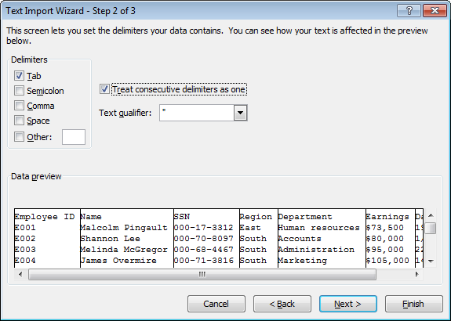
The Text Import Wizard

Slide 50
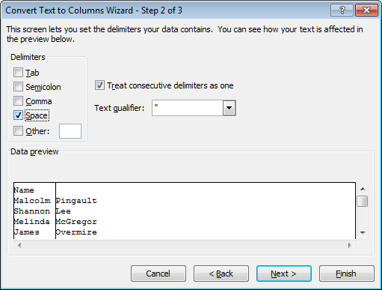
Converting text to columns

Slide 51
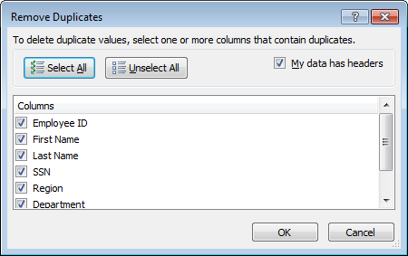
Removing duplicates

Slide 52
Unit 7: Analytical tools
Topic A: Goal Seek
Topic B: Scenarios
Topic C: Instant Data Analysis

Slide 53
Activate add-ins
Open the Excel Options dialog box
In the category list, select Add-Ins
From the Manage list, select Excel Add-ins, and click Go
Check the add-ins you want to activate, and click OK
Excel add-ins are automatically installed with Office Tools; if you haven’t installed Office Tools yet, you must do so now

Slide 54
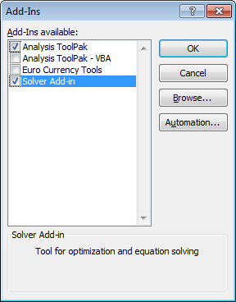
The Add-Ins dialog box

Slide 55
Use the Goal Seek utility
Click the Data tab
Click What-If Analysis and choose Goal Seek
Specify the cell that contains the formula you want to solve
Enter the result you want
Specify the cell that contains the value you want to adjust
Click OK

Slide 56
Create a scenario
Click the Data tab
From the What-If Analysis list, select Scenario Manager
Click the Add button
Specify the name of the scenario
Specify the cells containing the values you want to change, and click OK
Specify values for the changing cells, and click OK

Slide 57
Add a Scenario Manager button
Open the Excel Options dialog box, and select Quick Access Toolbar
From the “Choose commands from” list, select Data tab
In the list of commands, select Scenario Manager, and click Add
Click OK

Slide 58
Merge scenarios
Click the worksheet where you want to merge scenarios
Open the Scenario Manager dialog box
Click Merge
Select the worksheet that contains the scenarios you want to merge
Click OK

Slide 59
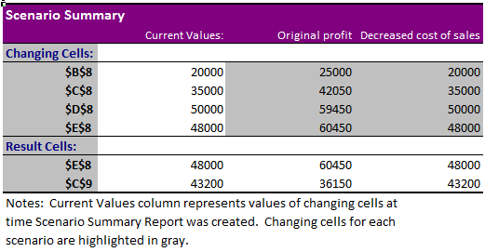
A sample Scenario Summary

Slide 60
Unit 8: Macros and Visual Basic
Topic A: Running and recording a macro
Topic B: Working with VBA code

Slide 61
Unit 9: Accessibility and Language Features
Topic A: Accessibility Considerations
Topic B: Internationalization

Slide 62
Course Review
Day 1
Unit 1: Advanced Functions and Formulas
Unit 2: Lookups and Data Tables
Unit 3: Advanced Data Management
Unit 4: Advanced Charting
Unit 5: PivotTables and PivotCharts
Day 2
Unit 6: Exporting and Importing
Unit 7: Analytical Tools
Unit 8: Macros and Custom Functions
Unit 9: Accessibility and Language Features

Slide 63
Class Evaluation
WD&CE Course Evaluation Form
http://webdb.montgomerycollege.edu/internet/wdceevals/wdceevals.cfm
Course Name: Excel 2013 Level III
Course CRN: 25715
Course Start Date: 10/2/2014
Course Instructor: Carl Burnett

