Slide 1
Microsoft Excel 2013
Level I www.profburnett.com

Slide 2
Outline
Introductions
Class Outline
Review Class Website

Slide 3
Instructor Info
Carl Burnett
Instructor with MCC since 2007
Also teaches at JHU & CTC
Military 22 Years – Corps of Engineers
IT Contractor 20 Years (BAH, GD, Independent)
profburnett@live.com
carl.burnett@montgomerycollege.edu
240.696.1906

Slide 4
Introductions
Name
Job
What do you to expect from the course?

Slide 5
Class Website
Class Website
Download Student Class Files
CertBlaster Software

Slide 6
Course Outline
Day 1
Unit 1: Getting started
Unit 2: Entering and editing data
Unit 3: Modifying a worksheet
Unit 4: Using functions
Day 2
Unit 5: Formatting
Unit 6: Charts
Unit 7: Graphics
Unit 8: Printing

Slide 7
Unit 1: Getting started
Topic A: Spreadsheet terminology
Topic B: The Excel environment
Topic C: Navigating a worksheet
Topic D: Using a template

Slide 8
Spreadsheet components
Column
Active cell
Value
Label
Row

Slide 9
Excel window components

Slide 10
Enhanced ScreenTips

Slide 11
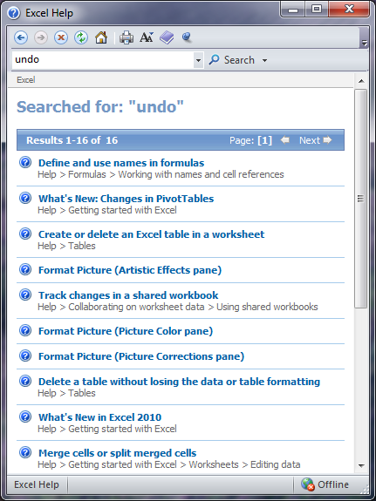
The Excel Help window

Slide 12
Worksheet navigation methods
Action | Result
Click a cell | Selects that cell
Press arrow key | Selects an adjacent cell
Press Tab | Selects the cell one column to the right
Press Shift+Tab | Selects the cell one column to the left
Press Ctrl+Home | Selects cell A1
Press Ctrl+End | Selects cell at intersection of last row and last column of data

Slide 13
Worksheet navigation, continued
Action | Result
Click scroll arrow | Moves view of worksheet one row or column Does not change the active cell
Click in scrollbar | Moves view of worksheet one screen up, down, left, or right, depending on where you click

Slide 14
Worksheet navigation, continued
Action | Result
Drag scroll box | Moves view of worksheet quickly without changing the active cell
Press Ctrl+G (or choose Edit, Go To) | Opens dialog box where you can enter a cell address
Drag slider on zoom bar | Zooms in or out on current document

Slide 15
Unit 2: Entering and editing data
Topic A: Entering and editing text and values
Topic B: Entering and editing formulas
Topic C: Saving and updating workbooks

Slide 16
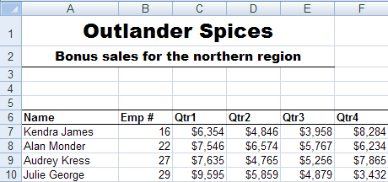
Spreadsheet with text and values

Slide 17
Editing text and values
Select the cell and type the new data
Click the formula bar, make the edits, and press Enter
Double-click the cell to place the insertion point in it, make the desired edits, and press Enter

Slide 18
Use AutoFill to enter a series
Select the cell containing the value that starts the list or series
Point to the fill handle until the pointer changes to a + symbol
Drag the fill handle over the adjacent cells that you want to fill

Slide 19
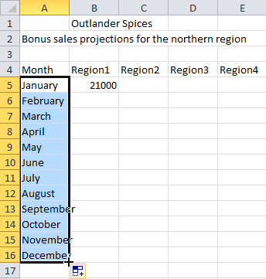
AutoFilling a month series

Slide 20
Formulas
Perform calculations, such as adding, multiplying, and averaging
Begin with the = sign
Use operators for calculations

Slide 21
Operators
Indicate the type of operation that a formula will perform
Operator | Used for | Example
+ | Addition | =A7+A9
- | Subtraction | =A7-A9
* | Multiplication | =A7*A9
/ | Division | =A7/A9
% | Percentages | =50%
^ | Exponents | =5^3 means 5³ or 5*5*5

Slide 22
Enter a formula
Select the cell where you want the result to appear
Type the equal sign (=)
Type the formula
Press Enter

Slide 23
Enter cell references with mouse
Select a cell
Type =
Click the cell for which you want to enter a reference
Type the operator
Repeat Steps 3-4 until your formula is complete
Press Enter

Slide 24
Order of operations
Percentages
Exponents
Multiplication and division
Addition and subtraction
When a formula contains operators with the same precedence, then calculations are performed from left to right

Slide 25
Save a workbook
Click the File tab and click Save As
Enter a name for the workbook
Select a location for the workbook
To save the file in a different format, select a file format from the Save as type list
Click Save

Slide 26
Save a file for Excel 97-2003
Click the File tab and click Save As
From the Save as type list, select Excel 97-2003 Workbook
Specify the file name and location
Click Save

Slide 27
Save a worksheet as a PDF
With the worksheet open, click the File tab and click Save As
Enter a name for the file (or use the current file name)
From the Save as type list, select PDF
Click Save
Excel converts the saved worksheet to a PDF file, and the current worksheet remains open in Excel

Slide 28
Unit 3: Modifying a worksheet
Topic A: Moving and copying data
Topic B: Moving, copying and viewing formulas
Topic C: Absolute and relative references
Topic D: Inserting and deleting ranges, rows, and columns

Slide 29
Move data in worksheets
Select the cell containing the data you want to move
Click the Home tab
Click Cut (or press Crtl+X)
Select the destination cell
Click Paste (or press Ctrl+V)

Slide 30
Copy data
Select the data you want to copy
Click Copy (or press Ctrl+C)
Select the destination cell
Click Paste (or press Ctrl+V)

Slide 31
Move data by dragging it
Select the cell that contains the data you want to move
Point to the border of the cell until the pointer changes to a four-headed arrow
Drag the cell to the destination
Release the mouse button

Slide 32
Copy data by dragging it
Select the cell containing the data you want to copy
Point to the border of the cell until the pointer changes to a four-headed arrow
Press and hold Ctrl; the pointer displays a plus sign (+)
Drag to the destination cell, release the mouse button, and then release Ctrl

Slide 33
The Office Clipboard
Integrated across all Microsoft Office applications
Expands the functionality of copy/paste and cut/paste
Can hold multiple items—you’re not limited to pasting the most recently cut or copied item
All items stored in the Office Clipboard are available to all open Microsoft Office applications

Slide 34
Relative references
Cell reference
Contains row and column coordinates to identify a cell
Relative cell reference
Refers to other cells in a formula based on the formula’s location
Automatically changes the references in a formula when it is copied

Slide 35
Absolute references
Don’t change when formulas are copied
Are specified by using a $ sign
$A$1
$C$2

Slide 36
Mixed references
Contain relative and absolute references
Relative references change when you copy the formula
Absolute references do not change

Slide 37
Insert a range
Click the first cell you want to select, and drag to the last cell you want to select
In the Cells group on the Home tab, click Insert
Choose Insert Cells
Specify whether you want to shift cells or insert an entire row or column, and click OK

Slide 38
Insert rows or columns
Select the row or column where you want to insert a new row or column
Do either of the following:
Right-click and choose Insert
Click Insert (in the Cells group) and then choose Insert Sheet Rows or Insert Sheet Columns

Slide 39
Delete a range
Select the range you want to delete
In the Cells group, click Delete (or right-click the selection and choose Delete)
Specify where to shift the adjacent cells
Click OK

Slide 40
Unit 4: Using functions
Topic A: Entering functions
Topic B: AutoSum
Topic C: Other common functions

Slide 41
Function
Predefined formula that performs a specific type of calculation
=FUNCTIONNAME(ARGUMENT1,ARGUMENT2,…)

Slide 42
Arguments
Are the input values for a function
Are enclosed in parentheses
Can be numbers, text, cell addresses, ranges, and other functions

Slide 43
Range reference
Specifies two or more cells
Starts with the address of the first cell, followed by a colon (:) and the address of the last cell in the range
A1:A4
B4:H10

Slide 44
The Error Checking button
Appears when Excel suspects that a formula contains an error
Provides options for fixing possible errors in a formula

Slide 45
Syntax errors

Slide 46
Insert a function
Select a cell
Click the Insert Function button on the formula bar
Select a function category and a function
Click OK
Specify the arguments
Click OK

Slide 47
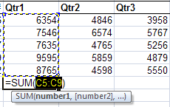
The AutoSum button
Automatically enters the function and its arguments
Guesses the range of cells that you want to add

Slide 48
AVERAGE function
Calculates the arithmetic mean of a list of values
=AVERAGE(number1,number2,…)

Slide 49
MIN function
Returns the smallest number from a list of values
=MIN(number1,number2,…)

Slide 50
MAX function
Returns the largest number from a list of values
=MAX(number1,number2,…)

Slide 51
COUNT function
Counts the number of cells in a range containing numeric values
=COUNT(value1, value2, …)

Slide 52
Unit 5: Formatting
Topic A: Text formatting
Topic B: Row and column formatting
Topic C: Number formatting
Topic D: Conditional formatting
Topic E: Additional formatting options

Slide 53
The Font group

Slide 54
Select a non-contiguous range
Select the first cell or range
While holding Ctrl, select any other cells or ranges you want to add to the selection

Slide 55
Format cells
Select the cell or range you want to format
Right-click the selection and choose Format Cells
Click the Font tab
Apply the desired formats, and click OK

Slide 56
Unit 6: Charts
Topic A: Chart basics
Topic B: Formatting charts

Slide 57
Create a chart
Select the headings and data you want in the chart
On the Insert tab, click a chart type
Select a sub-type
Use the options on the Chart Tools tabs to format and customize the chart
Move the chart to the desired location on the worksheet

Slide 58
Chart elements

Slide 59
Change the chart type
Select the chart
Under Chart Tools, click the Design tab and then click Change Chart Type
Select a chart type and sub-type
Click OK

Slide 60
Add axis labels
Select the chart
Click the Layout tab
In the Labels group, click Axis Titles
Choose a horizontal or vertical axis title
Enter the title text

Slide 61
Unit 7: Graphics
Topic A: Working with Pictures
Topic B: Conditional formatting with graphics
Topic C: SmartArt graphics

Slide 62
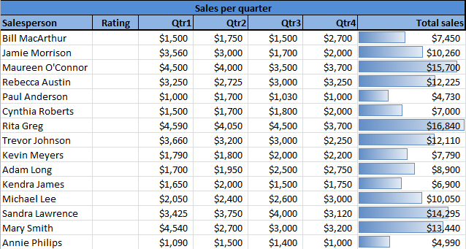
Data bars

Slide 63
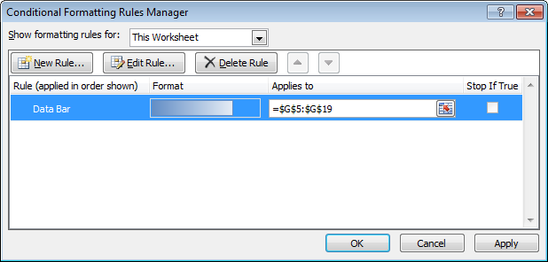
Conditional Formatting Rules Manager

Slide 64
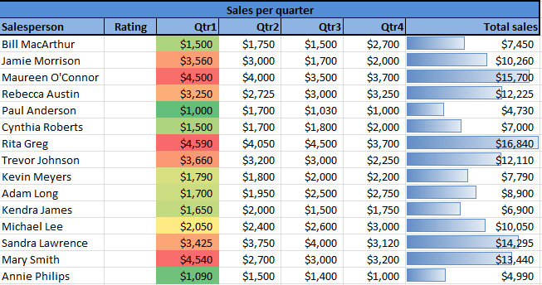
Color scales

Slide 65
Icon sets

Slide 66
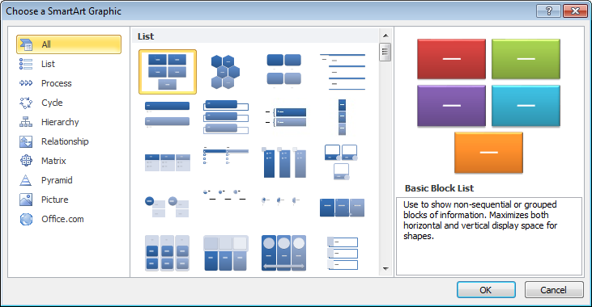
Creating SmartArt graphics

Slide 67
Quick Style and Bevel effects

Slide 68
Unit 8: Printing
Topic A: Preparing to print
Topic B: Page Setup options
Topic C: Printing worksheets

Slide 69
Use the spelling checker
Click the Review tab
Click Spelling; the first misspelling found is displayed
Click Change, click Add to Dictionary, or click Ignore All
Continue through the worksheet or range, responding to suggestions for each possible misspelling
Click OK

Slide 70
Use Find and Replace
Click the Home tab
In the Editing group, click Find & Select
Choose Replace
Enter the value or text you want to find
Click Find Next
Enter the new value or text
Click Replace, or click Replace All

Slide 71
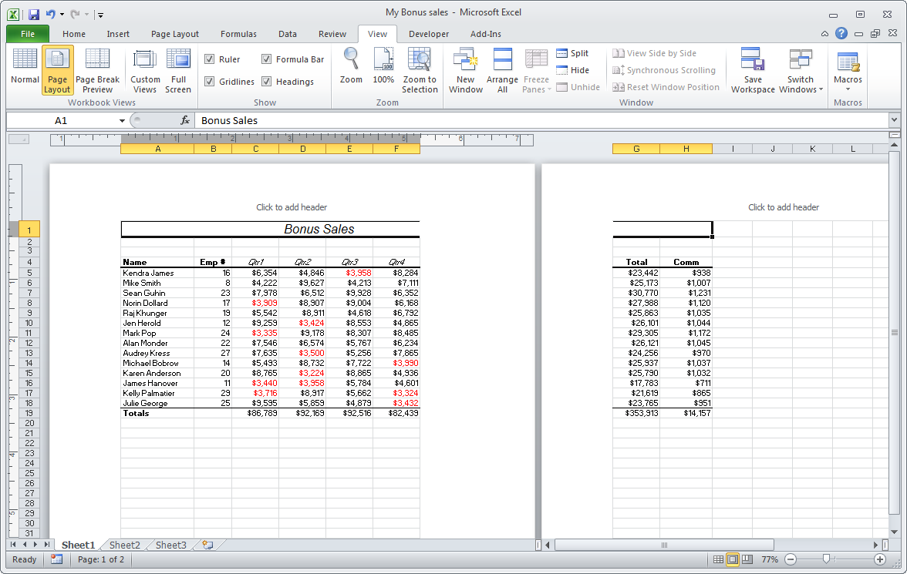
Page Layout view

Slide 72
Change scaling settings
At the bottom of the print options, click No Scaling (default setting)
Choose Fit All Columns on One Page or Fit Sheet on One Page, depending on which is better suited for your worksheet

Slide 73
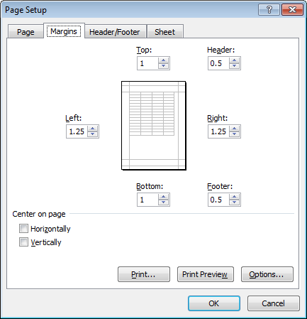
Setting custom margins

Slide 74
Add headers and footers
Click the Insert tab
In the Text group, click Header & Footer
Page Layout view is activated, with the Headers & Footer Tools | Design tab open
Add text and any other elements you want to include

Slide 75
Sheet options in Page Setup

Slide 76
When you’re ready to print…
Click the File tab
Click Print
Select a printer and other settings (page orientation, margins, scaling)
Click Print

Slide 77
Print a selection
Select the range you want to print
Click the File tab and click Print
Under Settings, click Print Active Sheets and choose Print Selection
Click Print

Slide 78
Course Review
Day 1
Unit 1: Getting started
Unit 2: Entering and editing data
Unit 3: Modifying a worksheet
Unit 4: Using functions
Day 2
Unit 5: Formatting
Unit 6: Charts
Unit 7: Graphics
Unit 8: Printing

Slide 79
Excel Level II - Course Outline
Day 1
Unit 1: Using multiple worksheets and workbooks
Unit 2: Advanced formatting
Unit 3: Outlining and subtotals
Unit 4: Cell and range names
Day 2
Unit 5: Data Structure and Tables
Unit 6: Web and sharing features
Unit 7: Documenting and auditing
Unit 8: Templates and settings

Slide 80
Excel Level III - Course Outline
Day 1
Unit 1: Advanced Functions and Formulas
Unit 2: Lookups and Data Tables
Unit 3: Advanced Data Management
Unit 4: Advanced Charting
Unit 5: PivotTables and PivotCharts
Day 2
Unit 6: Exporting and Importing
Unit 7: Analytical Tools
Unit 8: Macros and Custom Functions
Unit 9: Accessibility and Language Features

Slide 81
Class Evaluation
WD&CE Course Evaluation Form
http://webdb.montgomerycollege.edu/internet/wdceevals/wdceevals.cfm
Course Name: MS Excel 2013 Level I
Course CRN: 25710
Course Start Date: 9/18/2014
Course Instructor: Carl Burnett

