Slide 1
Digital Literacy for the 21st Century
Session VI – E-Learning & Discovery http://www.profburnett.com

Slide 2
Outline
E-Learning & Discovery Pyramid
eLearning Technologies
Search
Search Resources
Generalized vs Specialized Search
Custom Search Engines
Using your Social Networks

Slide 3
E-Learning & Discovery Pyramid
Curiosity
Information Retrieval
Learning
Discovery
Power to Reason
Decision-Making Skills
Relationships & Concepts
Active Participation
Self-Directed Interests
Guided

Slide 4
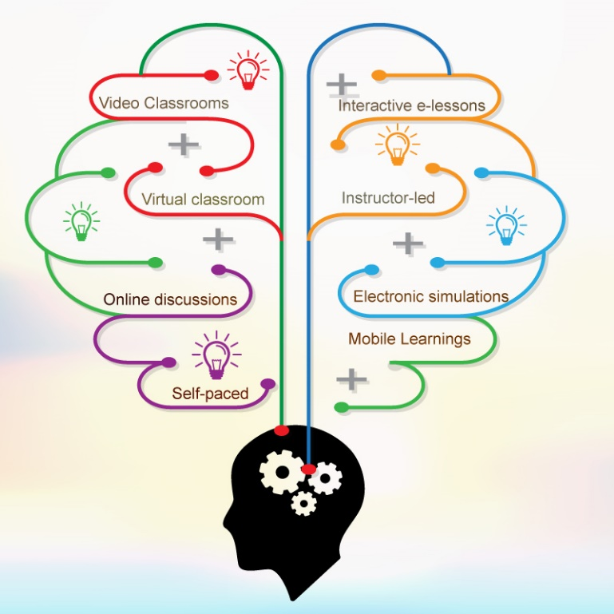
e-Learning Technologies
Video Classrooms
Virtual Learning Environment
Discussion Boards
Webcams
Whiteboards
Screencasting
Interactive E-learning
Electronic Simulations
Mobile Learning
MOOCs
Social Learning

Slide 5
Search
Search Resources
Generalized vs Specialized Search
Custom Search Engines
Using your Social Networks

Slide 6
Search Resources
Search Engines
Wikipedia
Dictionaries
YouTube

Slide 7
Generalized vs Specialized Search
Generalized
Google – 70%
Bing – 12.3%
Yahoo – 10%
Baidu – 6.5%
AOL - 1.1%
Others – 5,7%
Specialized
Wikipedia
Lycos
Google
Google Scholar
Google Patents
Google Legal Scholar
Google Trends
Google Alerts
Google Maps
YouTube

Slide 8
Custom Search Engines
Northern Light
Google Custom Search
Question & Answer
Quora
Evi
Wolfram Alpha
Dating – Badoo, Match
Music – Spitify, Last.fm
Movies - IMDB
Genealogy - Ancestry

Slide 9
Free Genealogy Websites
About.com
Ancestry.com
AfriGeneas
Archives.com
Cyndi’s List
FamilySearch.org
FamilyTreeMagazine.com
MyHeritage.com
National Archives Resources for Genealogists
USGenWeb Project

Slide 10
Using your Social Networks
Social Media Websites
Blogging Website
Microblogging
Genealogy Websites

Slide 11
Social Media Websites
Google+ - 1.6 B
Facebook - 1.2 B
Twitter - 645 M
Instagram - 330 M
Tumblr - 227 M
LinkedIn - 200M
Flixster - 63 M
Classmates - 50 M
Flickr - 32 M
MySpace - 30M
Foursquare - 20 M
LiveJournal - 17 M
SoundCloud - 10 M
delicious - 8 M
About.me - 5 M
Pinterest

Slide 12
Blogging Websites
Wordpress.com
Wordpress.org
Blogger
Tumblr
SquareSpace
Google+
Wix
Webbly
Webs

Slide 13
Microblogging Sites
Twitter
Yammer
Tout

Slide 14
Learning Modalities
Synchronous
Asynchronous
Linear
Collaborative

Slide 15
Information Categorization and Decisions
Classical categorization
Conceptual clustering
Prototype theory

Slide 16
Information Synthesis
What is synthesizing information?
Process of examining ideas and perspectives from different sources
Establishing connections between sources
Inferring relationships among sources
Making those relationships explicit.
<iframe width="560" height="315" src="https://www.youtube.com/embed/7dEGoJdb6O0" frameborder="0" allowfullscreen></iframe>

Slide 17
Interactive Information Engagement
Printed Materials | Visual Information | The Internet
Newspapers | Photography | Combines all other media sources to provide an interactive platform to engage in information retrieval, categorization and synthesis.
Magazines | Motion Pictures
Books | Videos
Periodicals | Graphic Arts
Booklets | Visual Aids & Displays
Brochures | Models & Sculpture
Mail

Slide 18
Knowledge Acquisition & Discovery
Combining and relating classical, computational and prototypical categorization.
Mash-up new inferences and explicit relationships from the categorized sources.
Create knowledge based on new ideas, focus, or perspective from the inferred and explicit categorized sources.

