Slide 1
Cloud Introduction
Session I http://www.profburnett.com

Slide 2
Outline
Course Overview Presentation
Introduction to Cloud Computing
Service Models - IaaS, PaaS, SaaS
Software as a Service (SaaS)
Consumer-Based SaaS

Slide 3
Cloud Computing?

Slide 4
The Cloud Stack
Software as a Service (SaaS)
Platform as a Service (PaaS)
Infrastructure as a Service (IaaS)

Slide 5
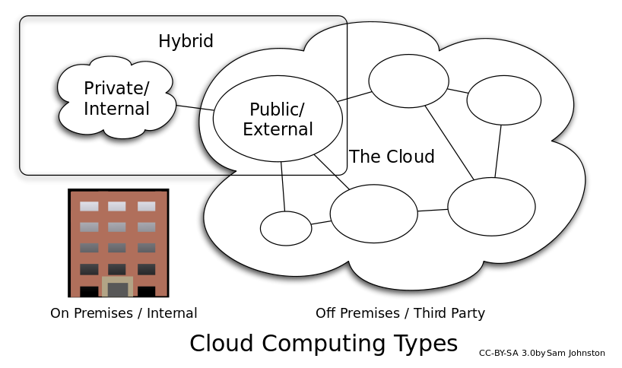
Deployment models

Slide 6
Cloud Computing Benefits
Agility
Cost reductions
Device and Location Independence
Maintenance
Multitenancy
Performance
Productivity
Reliability
Scalability and Elasticity
Security

Slide 7
Cloud Computing Issues
Reliability
Availability of services
Data access
Security
Complexity
Costs
Regulations and Legal Issues
Performance
Migration
Reversion
Lack of Standards
Limited Customization
Privacy Issues

Slide 8
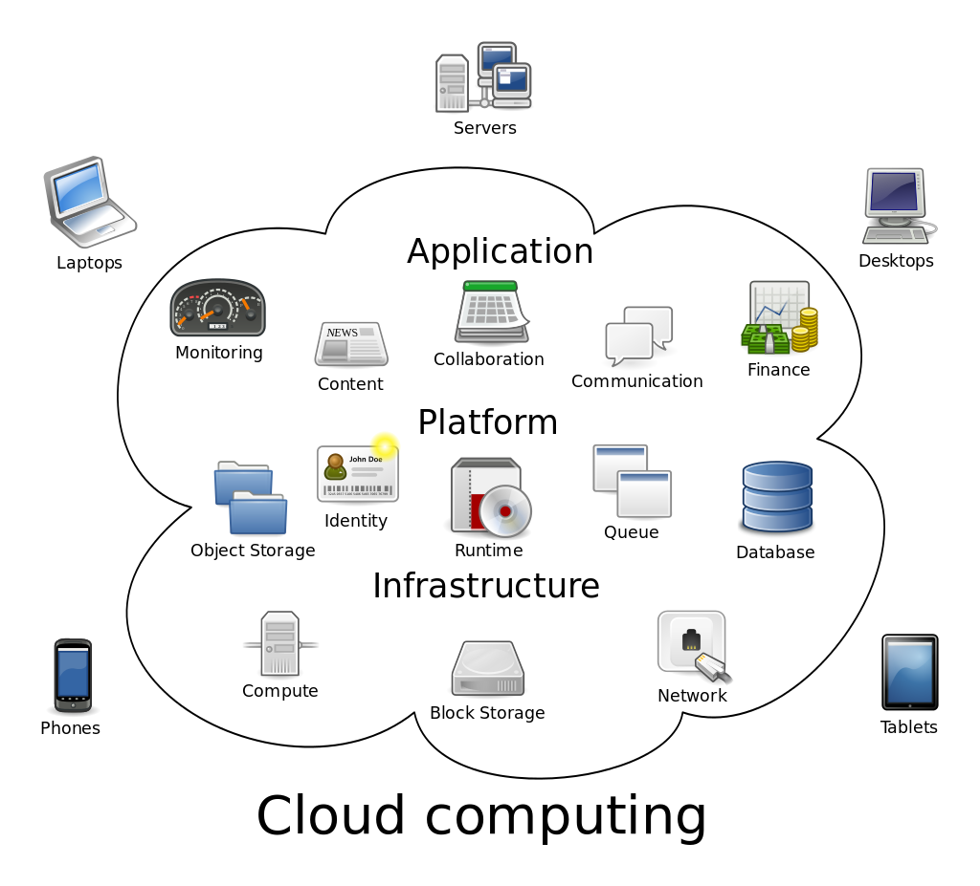
Service Models

Slide 9
Infrastructure as a Service (IaaS)
Service
Examples
Virtualization
Servers
Storage
Load Balancing
Network Services
Amazon Web Services (AWS)
Windows Azure
Google Compute Engine
Rackspace Open Cloud
IBM SmartCloud Enterprise.

Slide 10
Platform as a Service (PaaS)
Service
Examples
Development environment to application developers
Specialized Applications
Tailored Data Applications
Amazon Elastic Compute Cloud
Google App Engine
Windows Azure Development
Rackspace Cloud
Cisco Unified Computing System
Squarespace
Verizon Enterprise Solutions
GitHub

Slide 11
Software as a Service (SaaS)
Services
Examples
Business Applications
Customer Relationship Management (CRM)
Management Information Systems (MIS)
Enterprise Resource Planning (ERP)
Human Resource Management (HRM)
Talent Acquisition
Content Management (CM)
Antivirus Software
Service Desk Management (SDM)
Supply Chain Management (SCM)
Health Care Management

Slide 12
2015: Consumers Moving to the Cloud
Consumer Demands
Growth of Internet Users
Unfettered Access to Data
Multiple Devices
Location Independence

Slide 13
Technology Developments
Increased Internet Bandwidth
FTTH
Wireless Networks.
Powerful Portable Devices
Significantly Reduced Cost of Storage

Slide 14
Consumer-Based SaaS
Type
Key Drivers
Social Media
Video Services
Music Services
Communications
Software Applications
Digitalization
Cord Cutting
Open Source / Piracy
Utility Computing
VOIP

Slide 15
Next Session
Cloud Storage
Cloud Office Applications
Cloud Social Media
Cloud Media Services

Slide 16
Review
Course Overview Presentation
Introduction to Cloud Computing
Service Models - IaaS, PaaS, SaaS
Software as a Service (SaaS)
Consumer-Based SaaS

